Slide 1
Tip-thrust Rotary-wing Aircraft with Pitch Control- Rayde Krüger
1
Notes:
Good afternoon, everyone. My name is Rayde Kruger, and Ill be doing my report presentation on a Tip-Thrust rotary-wing aircraft with pitch control.
This presentation will focus on the mathematical model, design and the results of the project.

Slide 2
Contents Page
Content
Introduction and Motivation
Background
Mathematical Model
Modelling Rotor Thrust
Modelling Prop Thrust
Tip Thrust Position Optimization
Design
Final Design
Electronics and Control System
Efficiency
Results
Conclusion
2
Notes:
This presentation will focus on the mathematical model, design and the results of the project.

Slide 3
Introduction and Motivation
Objectives
Create a tip-thrust rotary-wing aircraft
Control the rotor’s pitch using the tip-thrust propulsion
Motivation
Reduce failure points
Reduce complexities
Reduces weight
Increased efficiencies
3
Notes:
The main objectives for my report were to create a tip-thrust rotary-wing aircraft which uses the tip-thrust to control the pitch.
The main advantage of doing this is it reduces failure points, mechanical complexity as well as the weight of the aircraft.
It will also provide better hovering efficiencies when compared to traditional quadcopters.

Slide 4
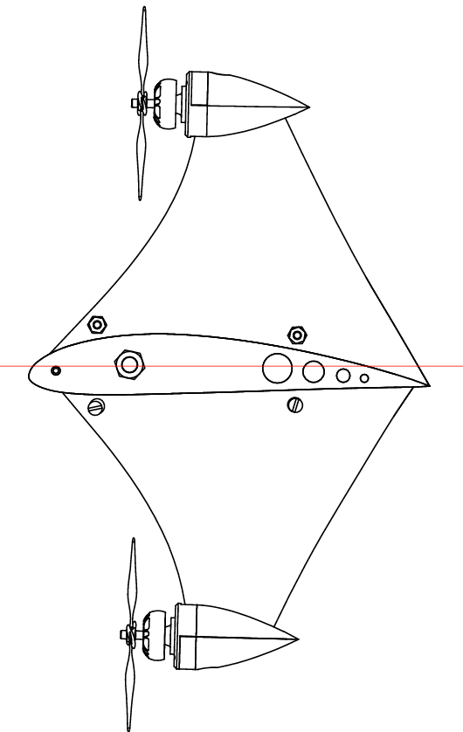
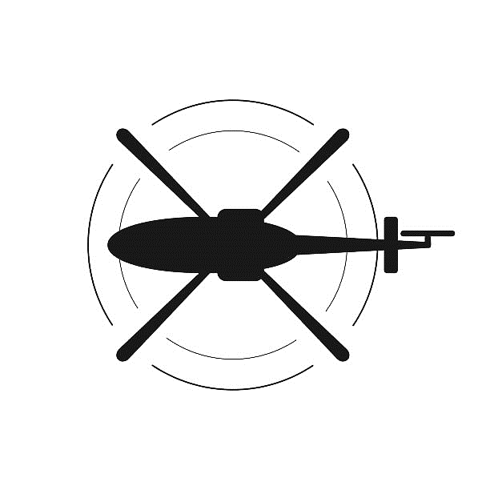
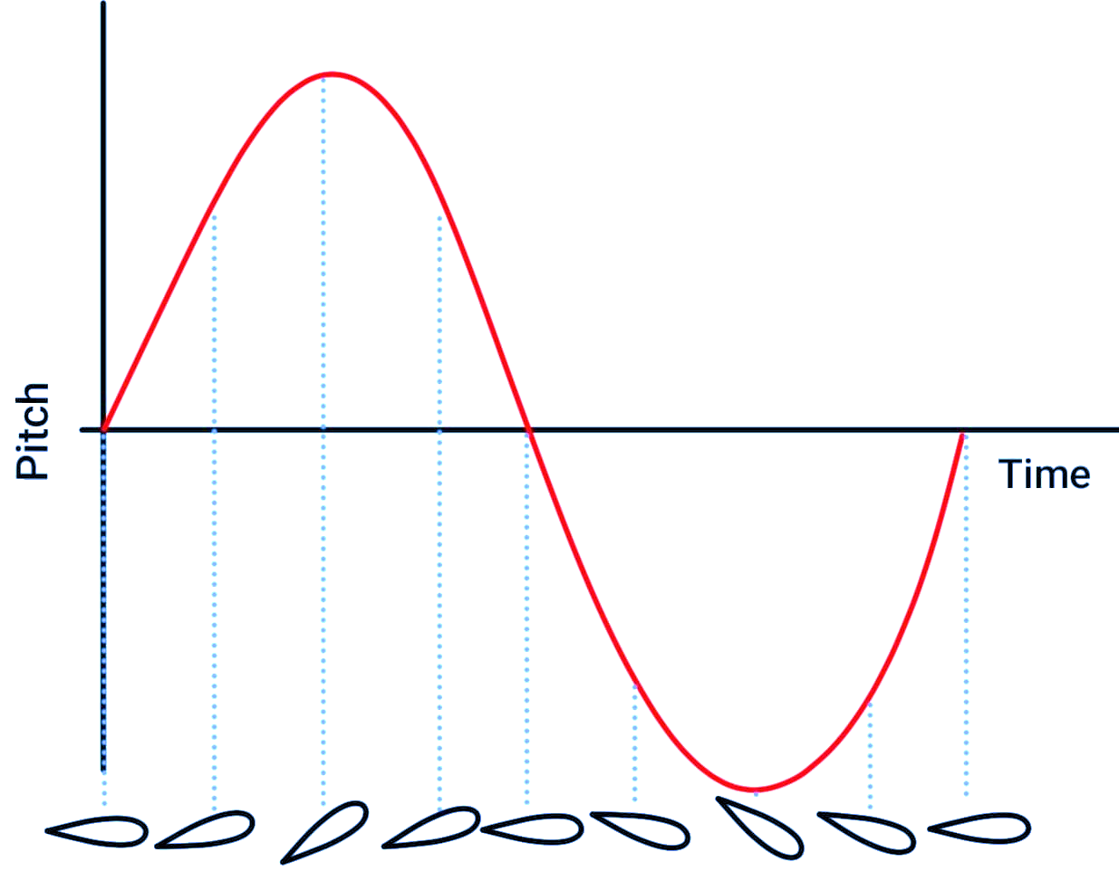
Background
Tip Thrust
Pitch Control
Tip Thrust uses propulsion on the rotor to create a torque
Removes the need for a tail rotor
There is no reaction toque such as in traditional helicopters
Two motors on each Rotor instead of a swashplate
Differential thrust creates a moment
Removes the need for a swashplate
Blade rotation
Torque
Blade rotation
Tip thrust
Tail rotor thrust
Photo by Kositskaya Olga
4
Notes:
Looking at tip-thrust helicopters the advantage of them is that they place the propulsion on the rotor blade to create the torque.
This removes the need for a tail rotor as it does not need to counteract the torque present with traditional helicopters.
Traditional helicopters use a swashplate to control the pitch of the rotor.
My report proposes using two motor to create a differential amount of thrust, which will create a moment that will then change the pitch of the rotor, thereby removing the need for a swashplate.
The first step in creating this aircraft was to make a mathematical model

Slide 5
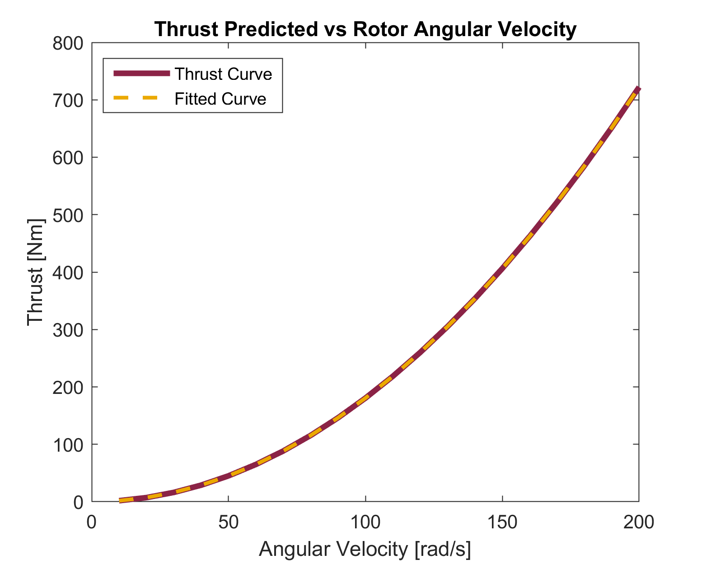



Mathematical Model (1 of 3)
Modelling Rotor Thrust
$$α$$
$$θ$$
Blade Element Theory was used to find the thrust and torque
The angle of attack was found through iteration and using Momentum Theory
Resulting in the reduced model:
Vaxial
Vtangential
V1
V2
[N]
V3
$$Thrust=0.01805ω_{Rotor}^{2}$$
-14
RMSE = 1.5 × 10
V4
5
Notes:
This model was based on Blade element Theory.
This takes the rotor and breaks it into multiple segments and a force balance is applied.
This determines the amount thrust and drag of each segment.
The thrust and drag force is dependent on the Angle of Attack.
This is the angle between the rotor and the incoming air velocity.
While the tangential velocity can be found using the angular velocity of the rotor, the axial component needs to be found using Momentum Theory and through iteration.
Summing up the amount of thrust produced and plotting this over the angular velocity of the rotor results in the graph shown in purple.
To reduce the complexity of the model, an exponential graph was fitted to the data.
As can be seen by the yellow graph, it fits the data extremely well, with a root mean square error of effectively 0.

Slide 6
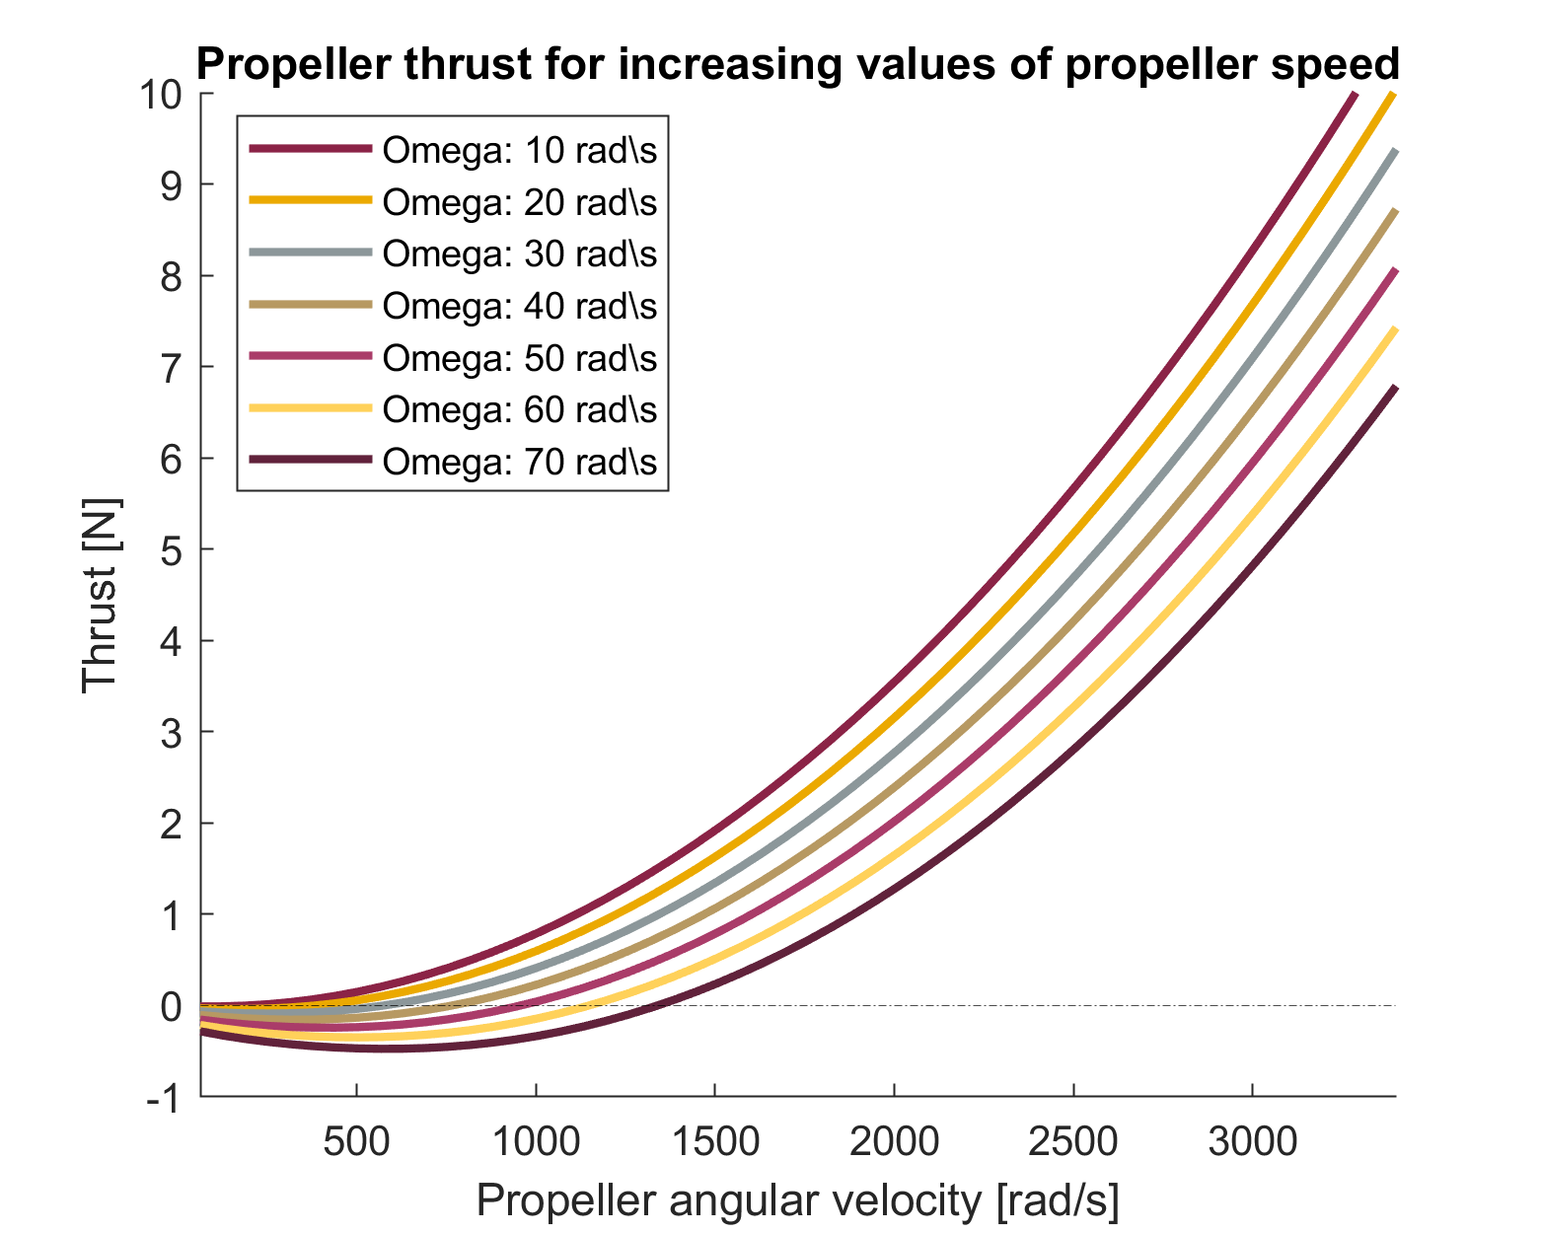
Mathematical Model (2 of 3)
Modelling Propeller Thrust
Incoming air speed can be estimated by the angular velocity of the rotor
Each graph has a parabolic shape:
$$T_{prop}=P_{1}ω_{prop}^{2}+P_{2}ω_{prop}+P_{3}$$
Where the coefficients change according to the angular velocity of the rotor
Results of Model
The model assisted with:
Dimensioning the rotor
Finding requirements for the motors and propellers
Showing the tips is not the optimal placement
6
Notes:
A similar method was done for the tip-thrust propellers, except the incoming airspeed was estimated by the angular velocity of the rotor multiplied by the distance to the tip-thrust motors.
This results in the thrust graph shown. While all the graphs are parabolic in nature, their shapes vary with changes in the rotor’s angular velocity.
By fitting a parabolic equation to each graph, it can be observed that the coefficients of the parabolas change according to the angular velocities.
By finding a relationship between these coefficients and the angular velocity the thrust of the propellers can be fully described.
Now that the system can be fully described by the model, it allows us to find the dimensions of the rotor, find the requirements for the motors and propellers and most importantly, it showed that the tip is not the optimal placement for the thrust.

Slide 7
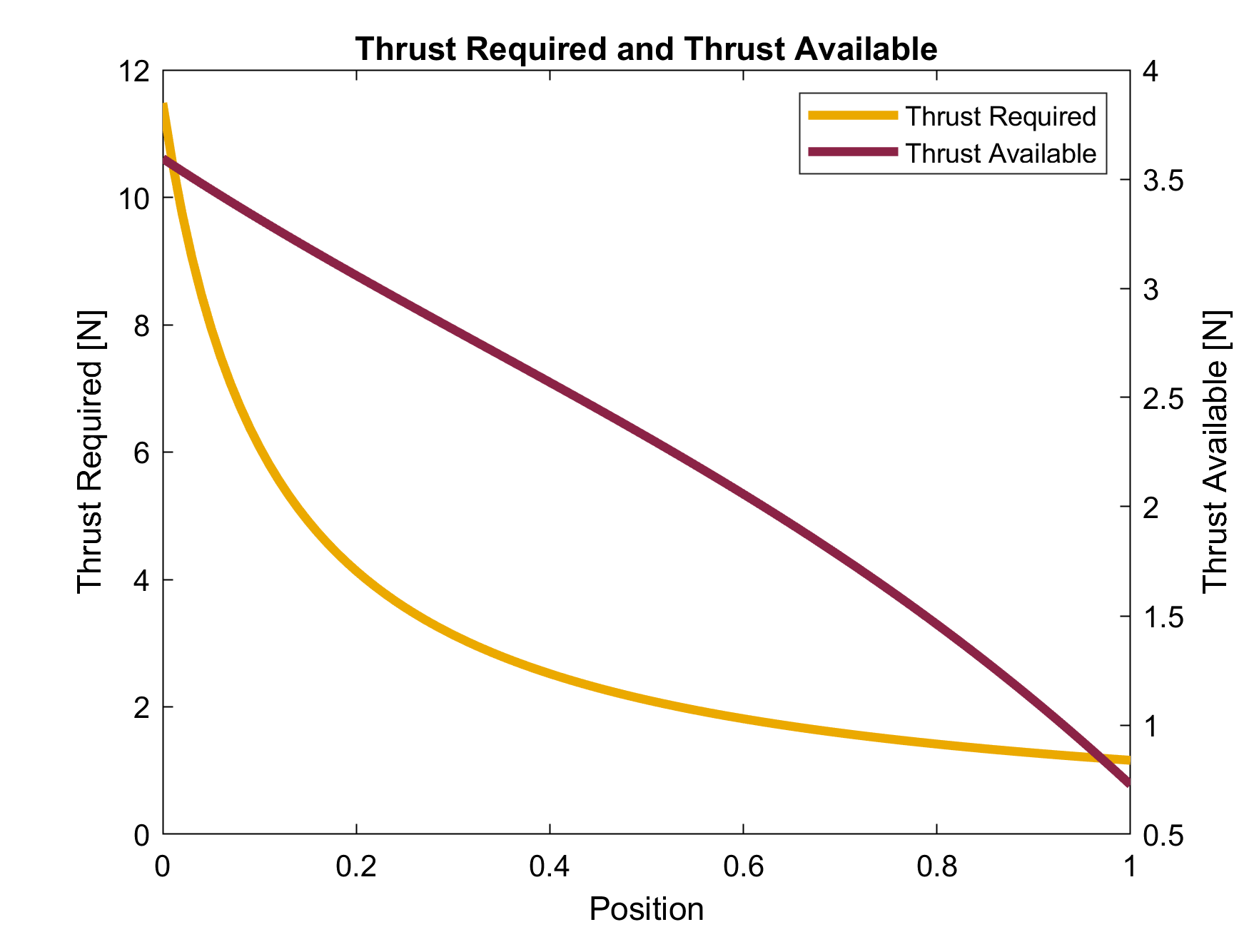
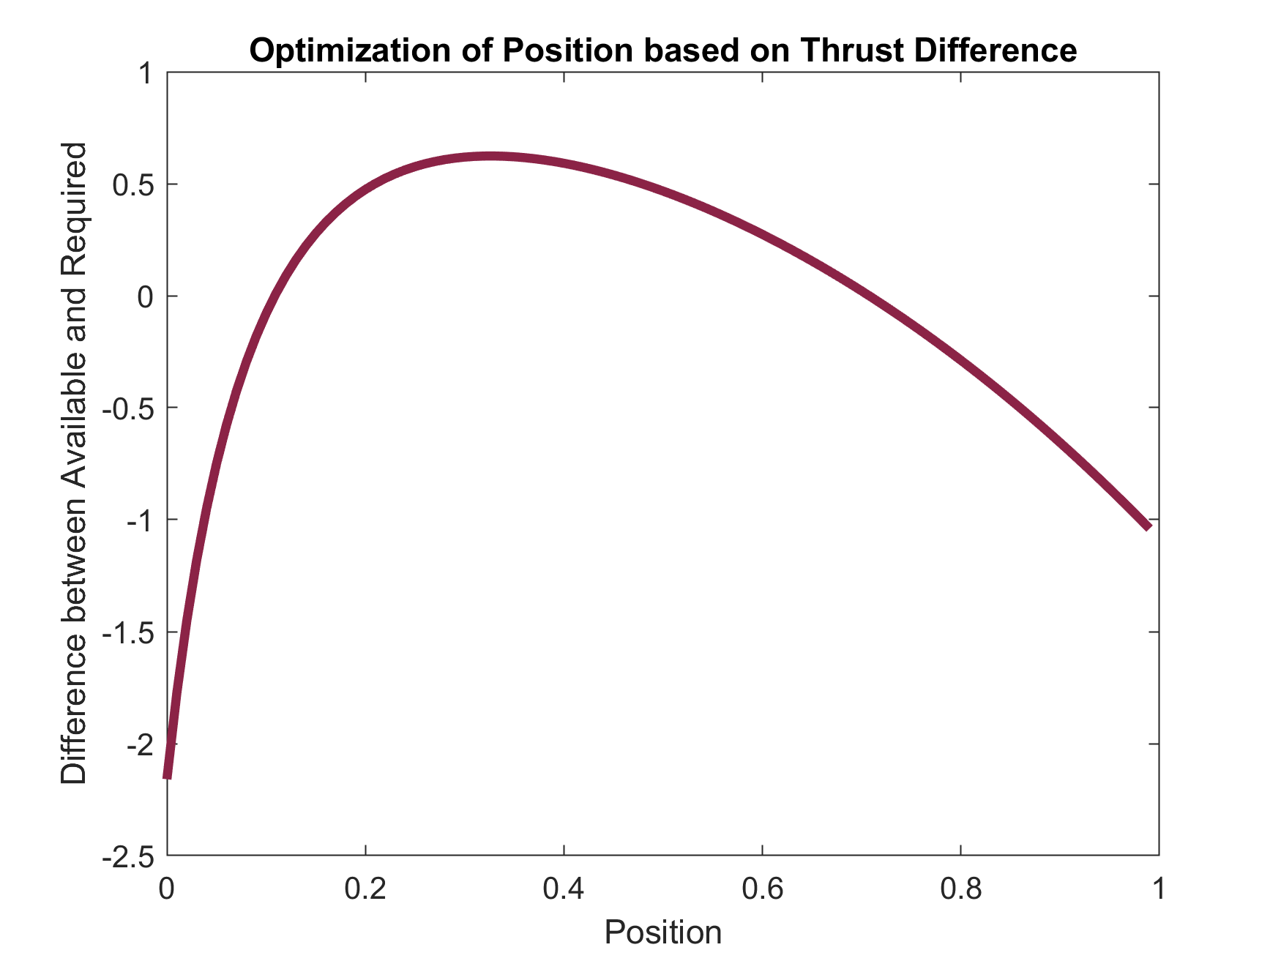
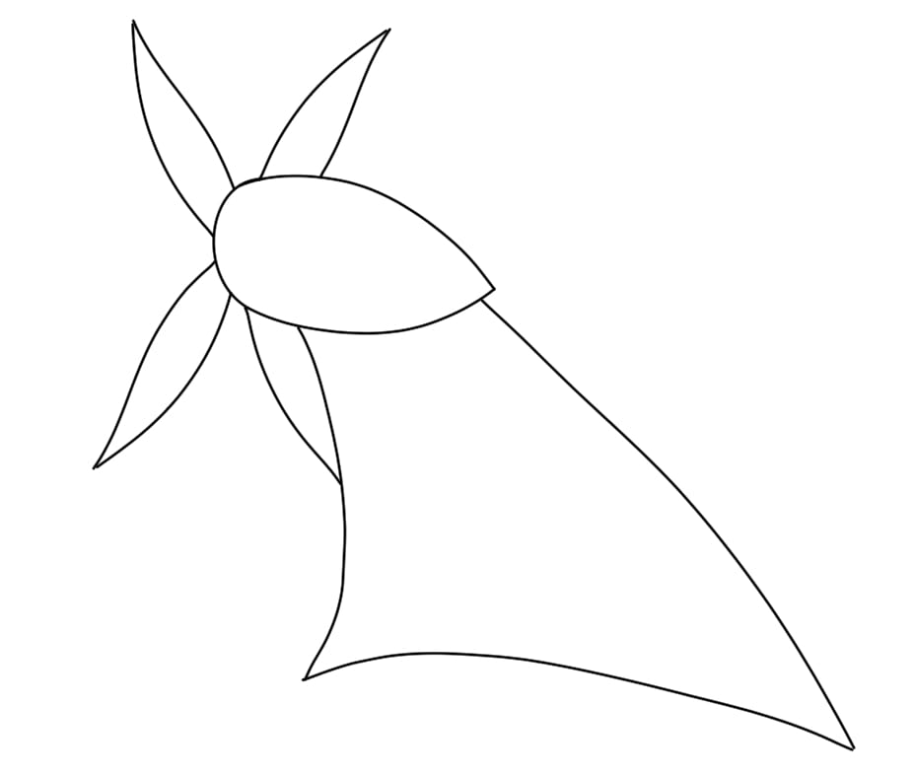
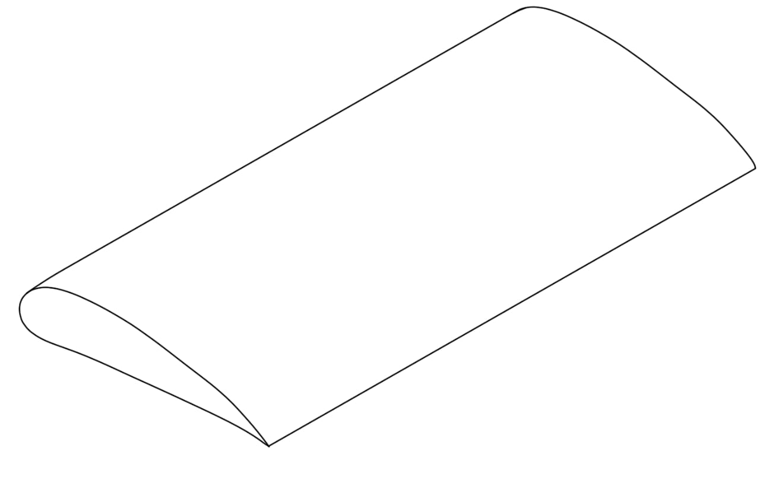
Mathematical Model (3 of 3)
Tip Thrust Position Optimization
Thrust available decreases as the torque produced increases
32.5 % of the rotor length
7
Notes:
Initially the thrust was placed on the tip as it produces the maximum amount of torque, however it will also have the highest incoming air velocity, which will reduce the angle of attack.
This results in the propellers producing less thrust.
To find the optimum placement all variables were kept constant except for the position of the tip thrust along the rotor.
The yellow graph shows the amount of thrust that is required to produce the set torque value and the purple graph shows the amount of thrust that is produced by the tip thrust as it moves along the rotor.
These two graphs were standardized and subtracted from each other to find the optimal point, which was seen to be at 32.5% along the rotor.
This can be seen on the final design.

Slide 8
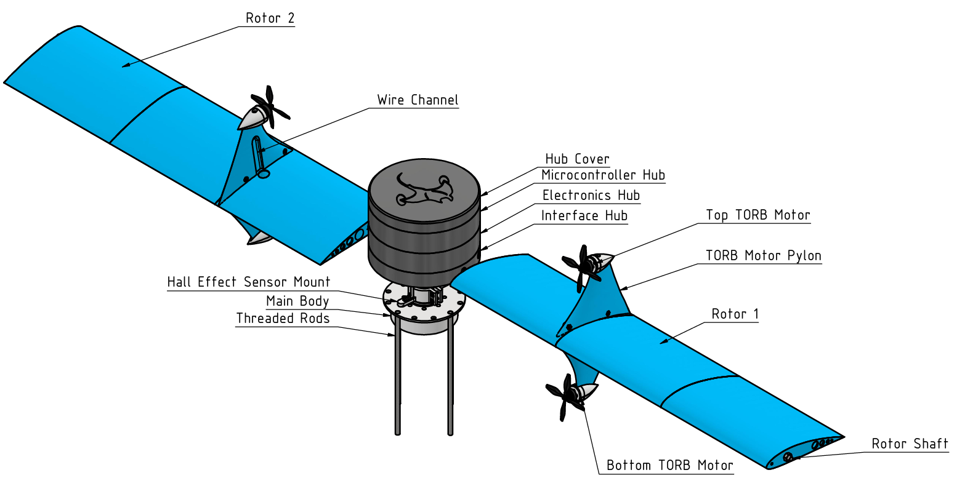
Design (1 of 2)
Final Design
8
Notes:
From this point these motors were given the acronym TORB, Thrust on Rotor Blade, to more accurately describe the propulsion method used.
Two of these are attached to each rotor blade.
Each of the rotor blades are connected to hub and interface with a potentiometer to detect the pitch of each rotor.
Similarly, where the hub connects to the main body, two hall effect sensors are used.
One to detect position and one to detect the speed.
The hub is currently powered with a slip ring contains the electronics for the aircraft.
This includes a wireless transceiver module which sends this data to be received by the computer.
These are received by the microcontroller and are used as inputs for to the PID control system.

Slide 9
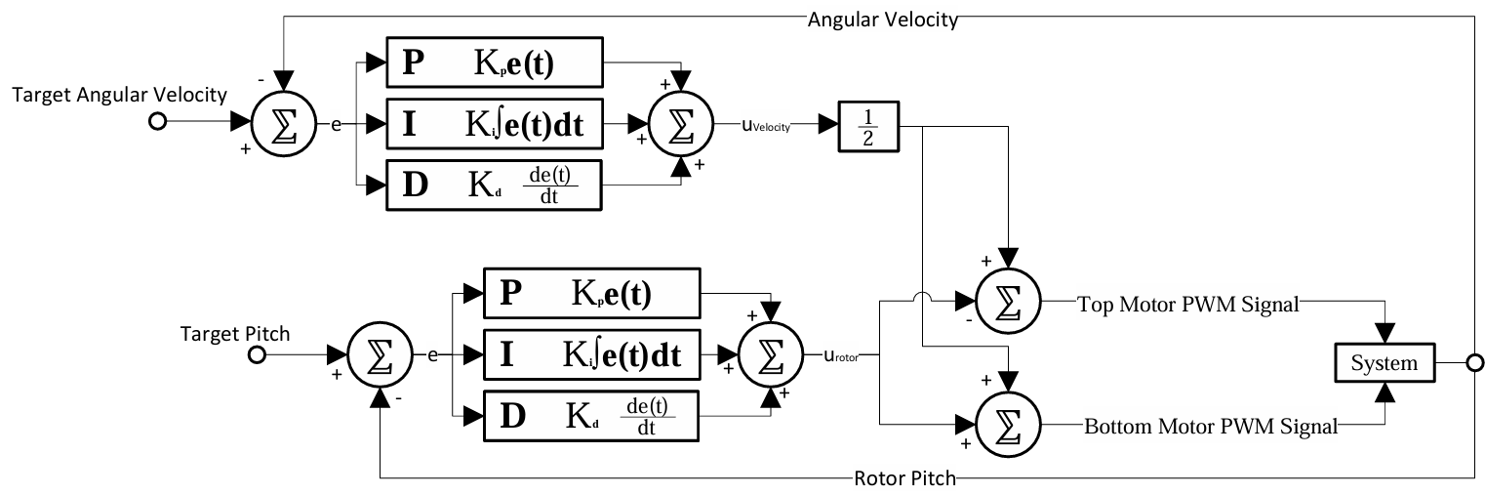
Design (2 of 2)
Electronics and Control System
The microcontroller receives inputs from the hall effect sensors and potentiometer
The control system determines the PWM signal for each brushless motor
9
Notes:
Two PID controls are used, one controls the speed and the other two controls the rotor pitch .
The PWM signal for each motor was found by halving the speed control signal, and then taking the pitch control signal and adding it to the one motor and subtracting from the other.
This results in the final PWM signal for each rotor blade motor.

Slide 10
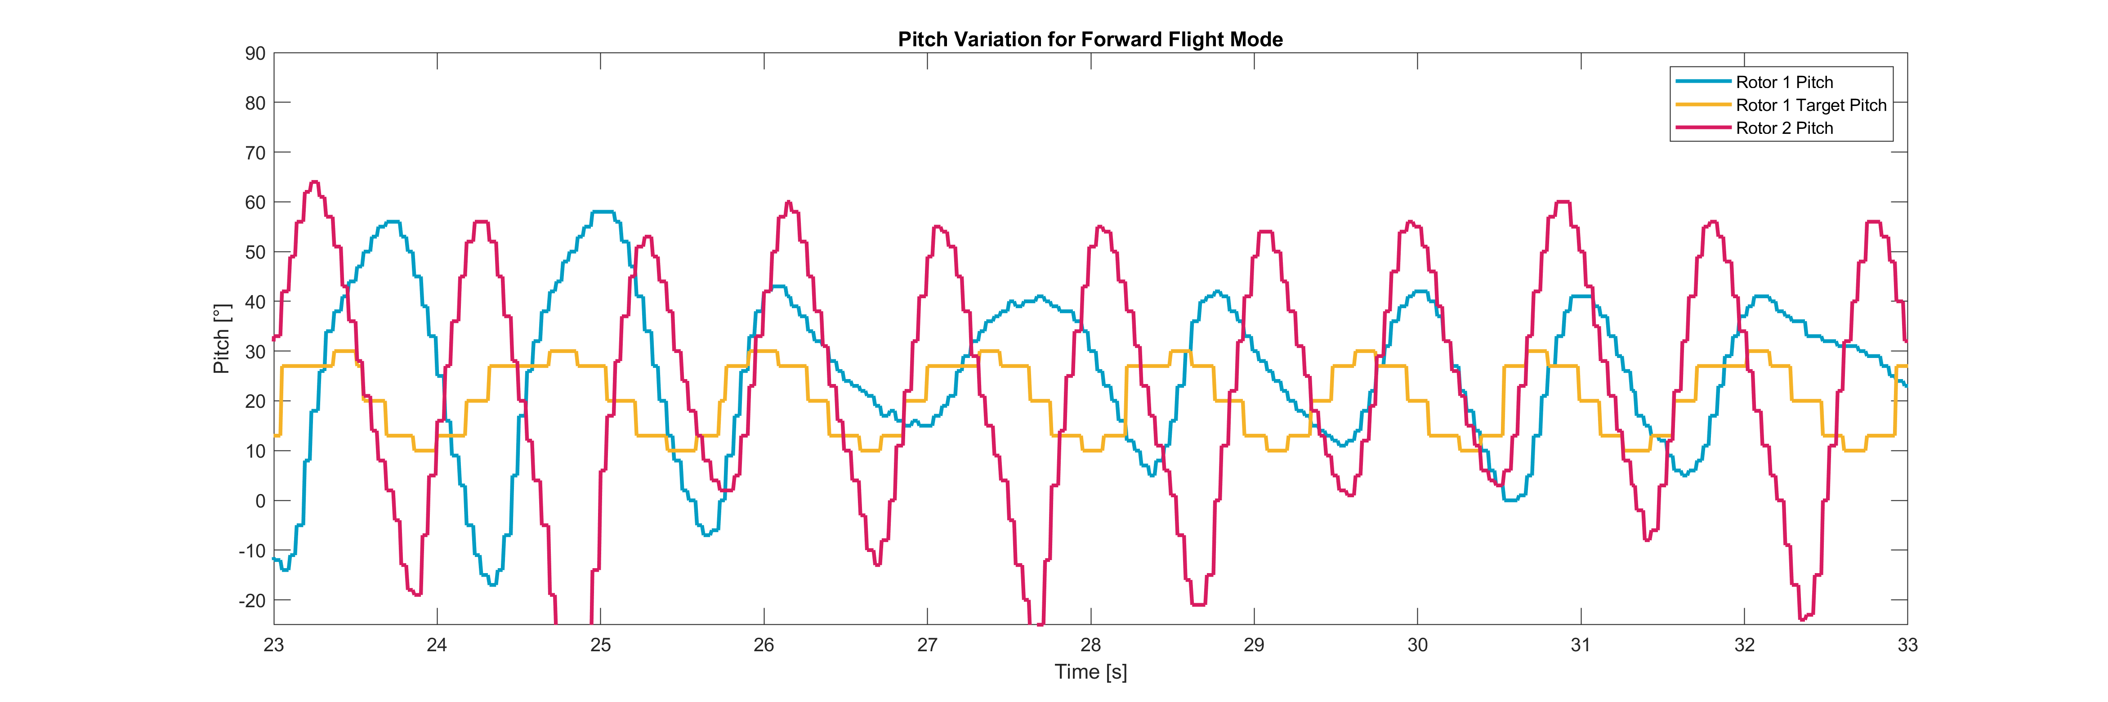
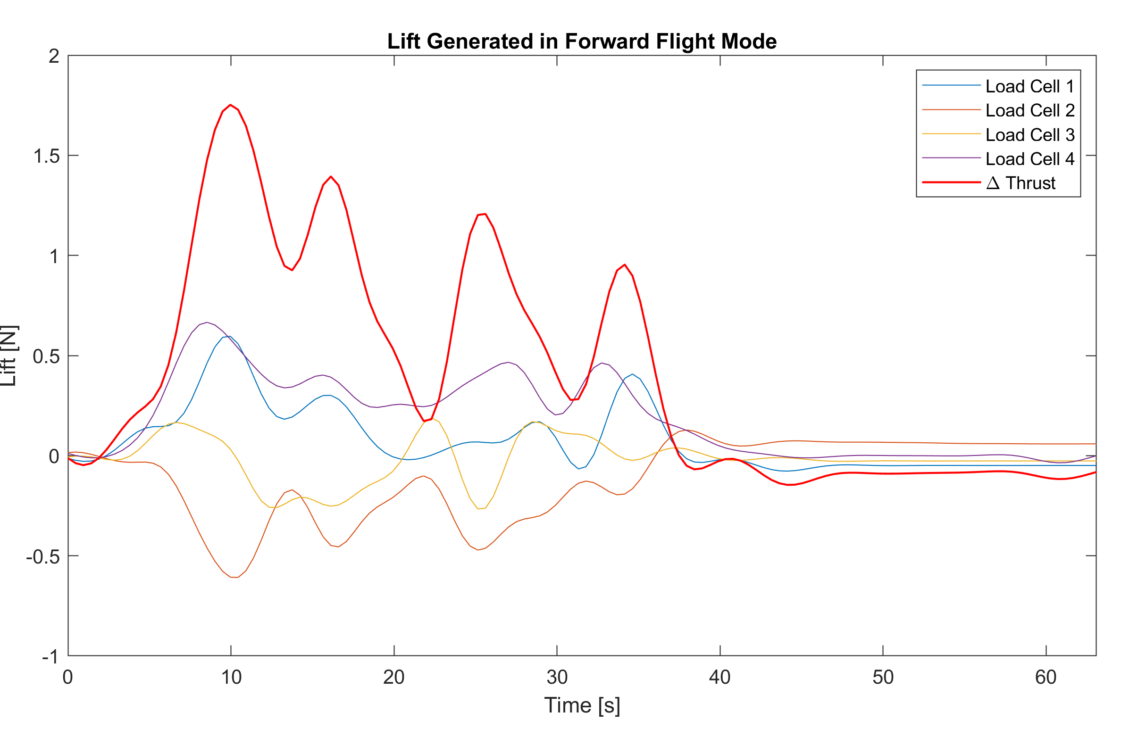
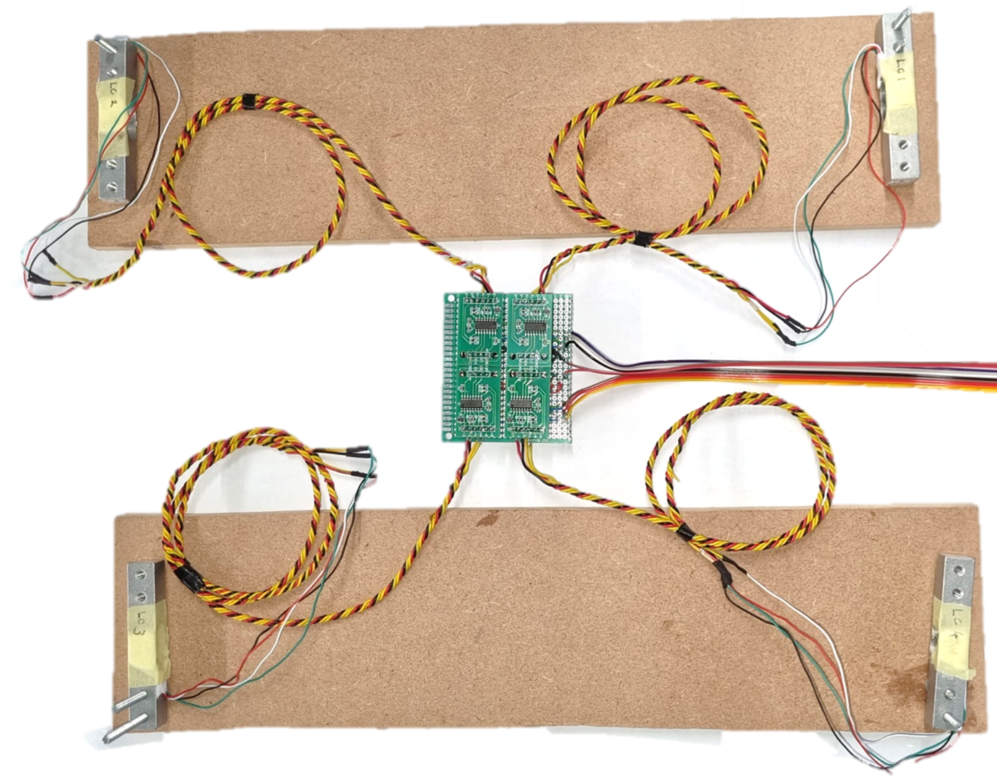
Experiment Results (1 of 3)
Directional Flight
A test bench was made using loadcells
Rotor reached maximum pitch between Loadcells 1 and 2
Due to Gyroscopic Procession, the upward movement is felt by Loadcell 1 and 4
Load cell 2
Load cell 1
Aircraft’s Forward Direction
Load cell 3
Load cell 4
10
Notes:
After the aircraft was built and programmed and test bench was created.
This used 4 loadcells one in each corner to ensure directional thrust can be measured.
This was taken into the structure’s lab testing pit to allow the proof of concept to be tested in a safe environment.
The graph given shows the target pitch for rotor 1, in yellow, which is followed, with a slight offset by the blue graph which shows the actual pitch for rotor one.
Similarly, the Pitch for rotor 2, in pink gives shows that it is offset by 180.
This ensures that both rotors have the maximum pitch between loadcells 1 and 2, producing an upward force at this point.
Looking at the results it can be see that the upward force created results in an upward movement felt by load cells 1 and 4, this is due to gyroscopic procession. This would tilt the aircraft forward showing directional thrust can be achieved.

Slide 11
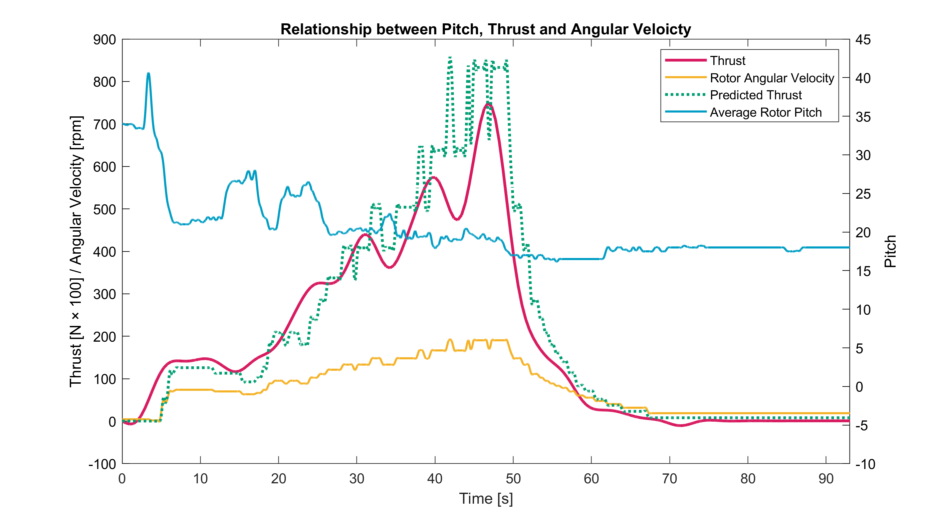

Experiment Results (2 of 3)
Model Prediction
The final model was changed to account for the TORB’s propulsion:
Fitted Torque Equation
Rotor Pitch
$$T=ω_{rotor}^{2}\left(0.01805+\frac{0.002216}{0.2625}\sin\left(20\right)\right)$$
Fitted Thrust Equation
Distance to TORB
The model resulted in an average RMSE of 0.6529
11
Notes:
The next test was to determine the accuracy of my model.
After looking at the results, the only change made to model was that the component of vertical thrust produced by the TORB Motors were added.
Looking at the graph shows that the actual thrust, shown in pink, follows the predicted thrust, shown in green reasonably well.
The average RMSE over the tests was 0.6529, which has an average error rate of under 10%, which can be a good fit.

Slide 12
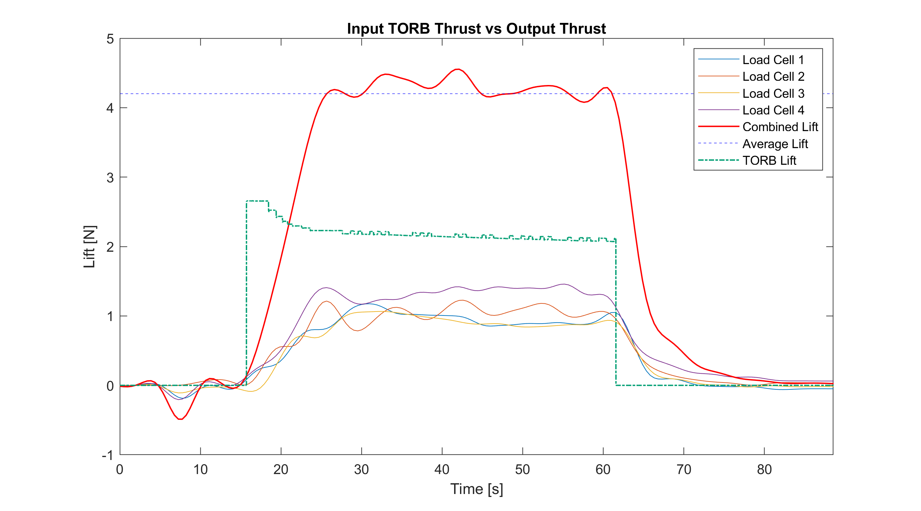
Experiment Results (3 of 3)
Efficiencies
The total input TORB thrust was 2.2 N
The overall lift produced by the aircraft was 4.2 N
Resulting in an efficiency of 190%
12
Notes:
Another aspect of the design is the aircraft’s hovering efficiency.
The aircraft in this test is able to achieve an overall average lift force of 4.2 N with an average input of 2.2 N.
Resulting in a lift efficiency of 190%.

Slide 13
Conclusion
Future Development
Using the verified model, a more sophisticated control system can be implemented
Add a power system and stability control to allow for the system to take flight
Conclusion
Demonstrated feasibility aircraft controllability with pitch control
Found the optimum TORB placement
13
Notes:
Over the year, I was able to create mathematical model which describes the aircraft.
Using the model, the aircraft and its electronics was designed and built a working proof of concept.
Going forward, the largest improvements can be made to the control system.
Using the verified model, either a lead/lag compensator or a state space control system can be implemented.
This with a more accurate method to detect pitch would greatly improve the model’s construability.
Secondly, to make the aircraft into an aircraft and not the over engineered fan that it currently is, a stabilisation control system should be implemented as well as a battery power system.
The two most significant outcomes from this report was that it showed that the optimal thrust placement was not on the tips, but rather closer to the hub and most importantly demonstrating feasibility of using the novel concept to control the rotor pitch. I am working with Dr Gill with the aim to get this unique concept published in a scientific journal.
Thank you very much.

Slide 15
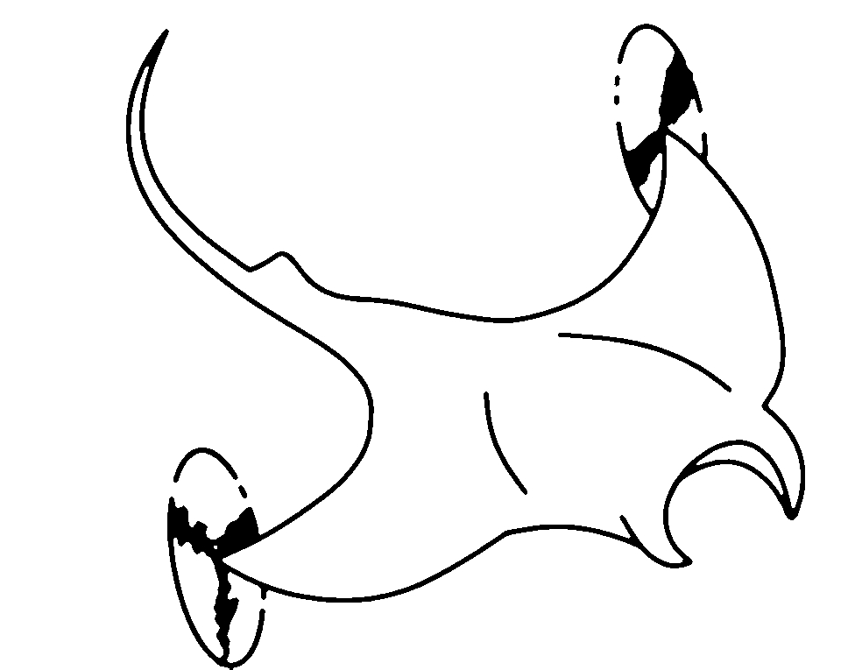
Thank you
14
Notes:
Thank you so much for listening to my presentation and reading my report, I hope you found it to be an interesting topic.

Slide 16
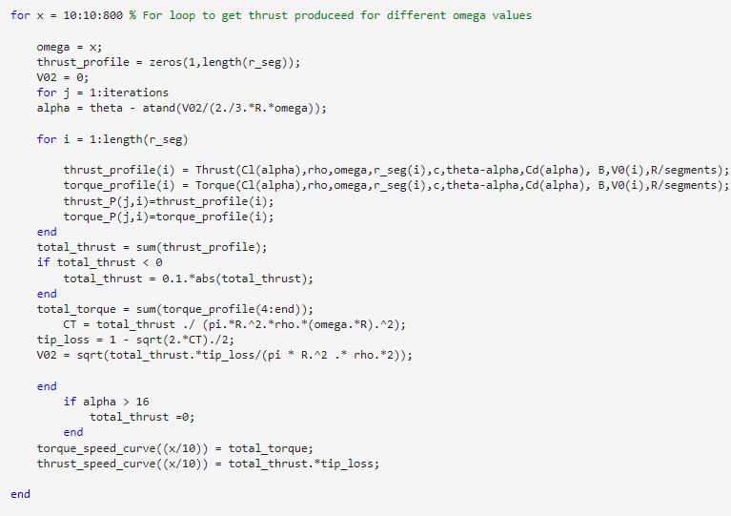
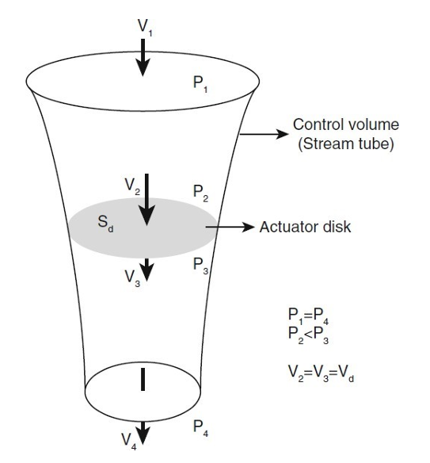
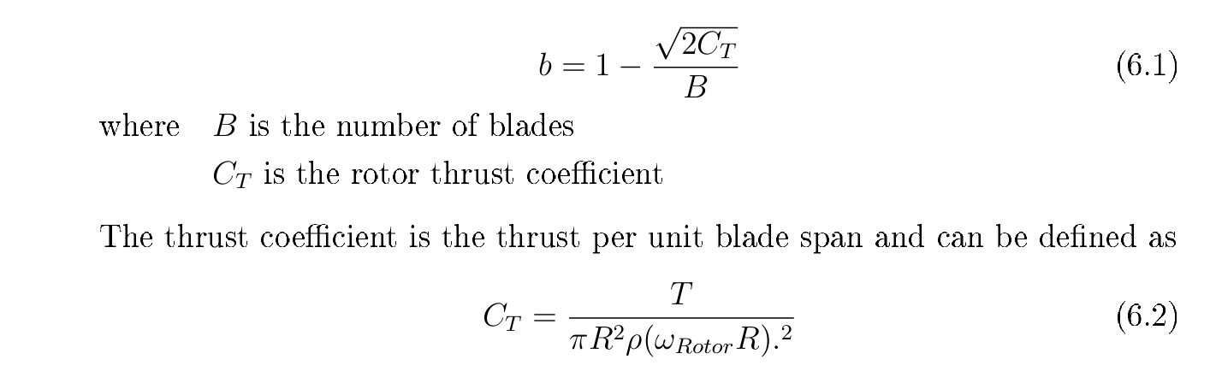
MATLAB Code
Blade element analysis

Slide 18
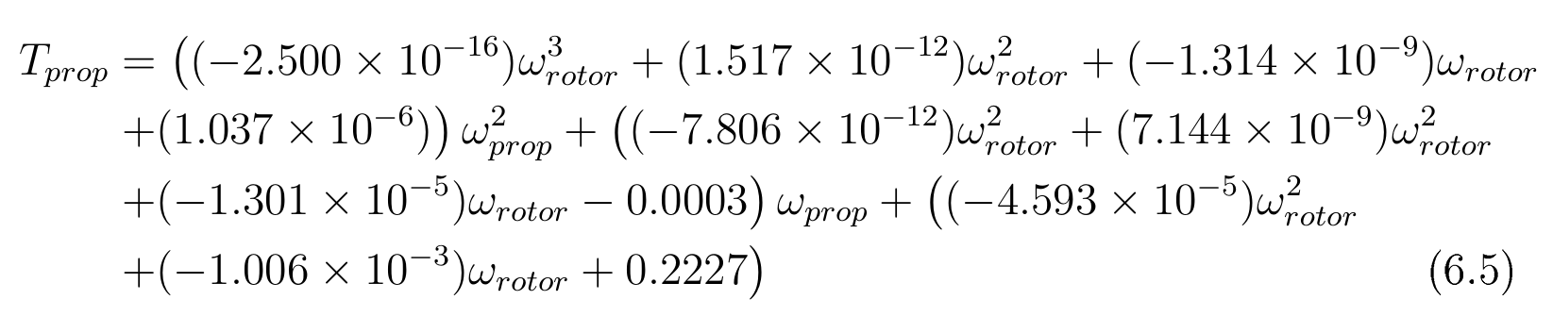
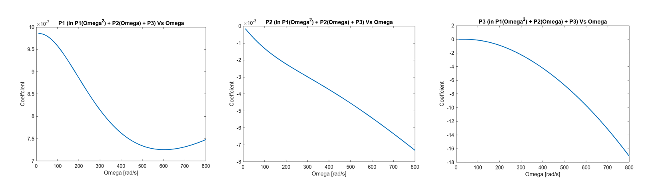
TORB Thrust

Slide 19
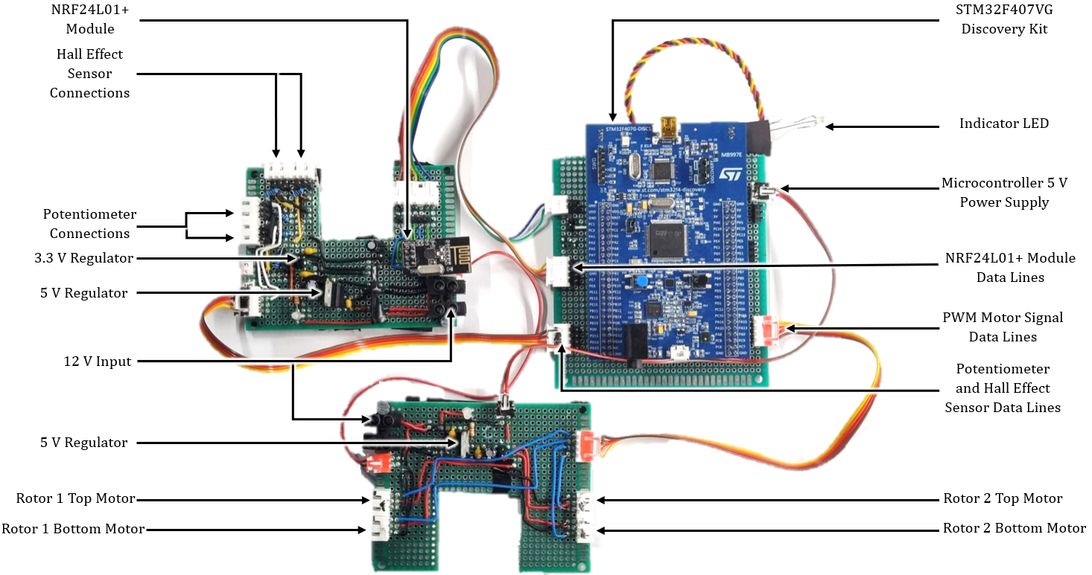
Electronics

Slide 20
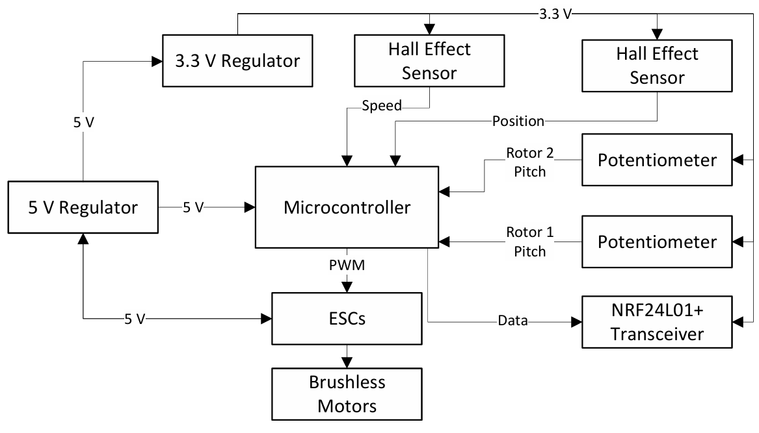
Electronics

Slide 21
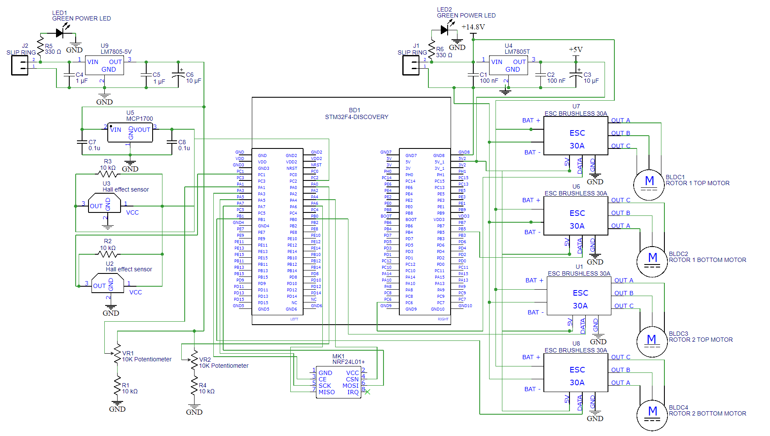

Slide 22
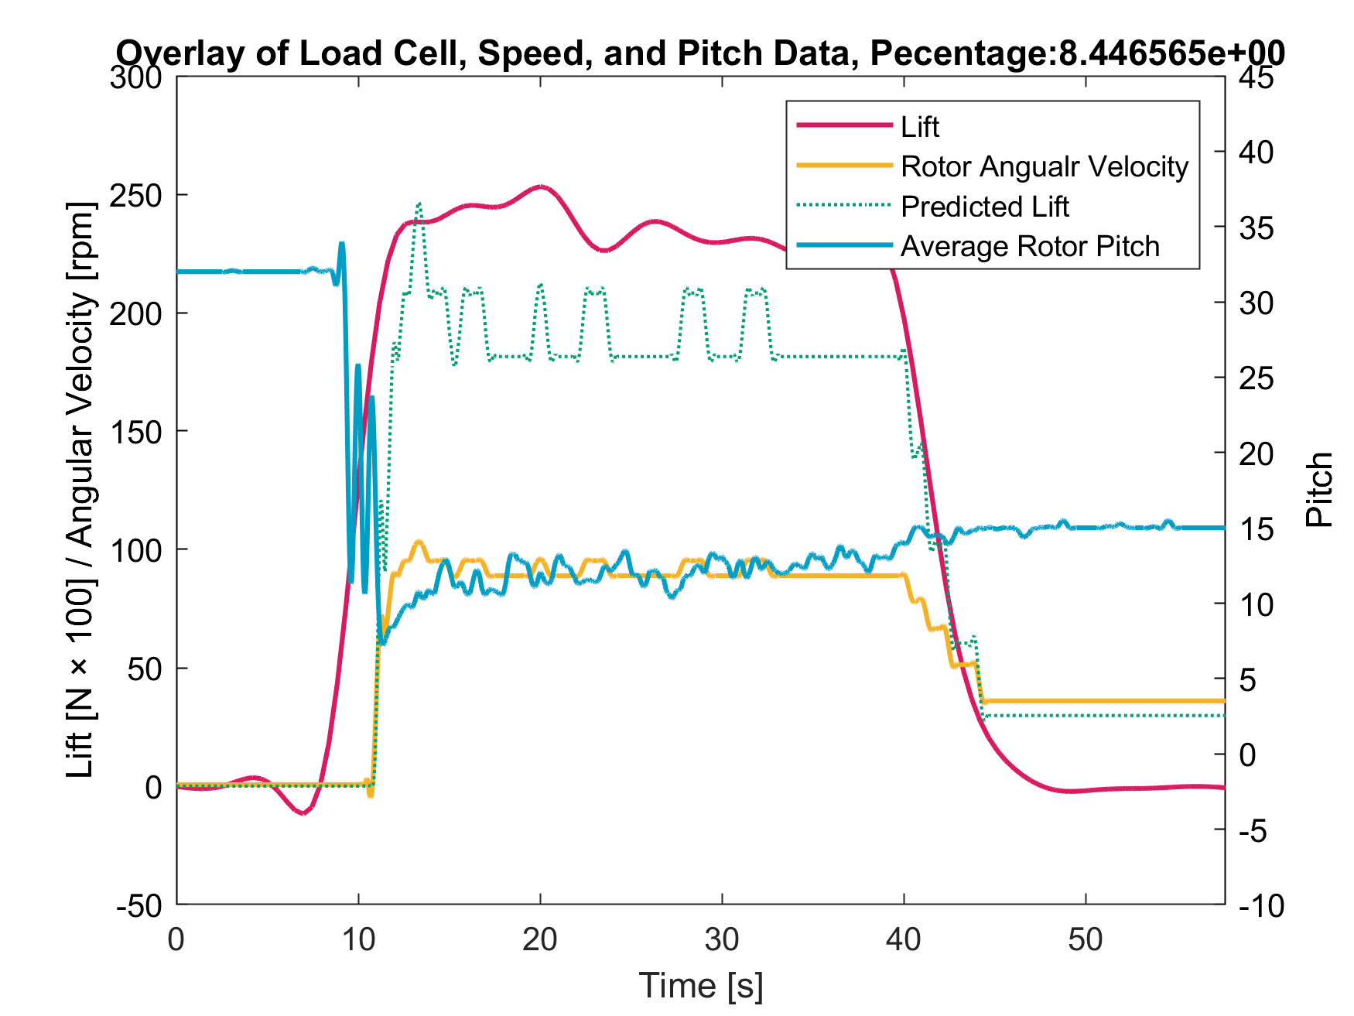
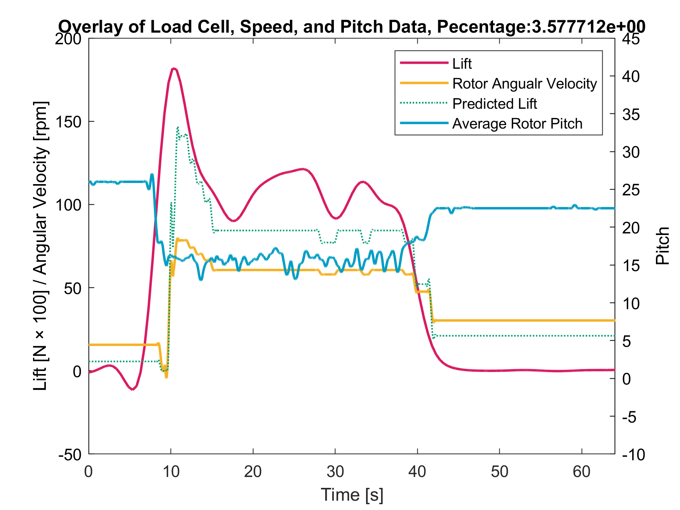
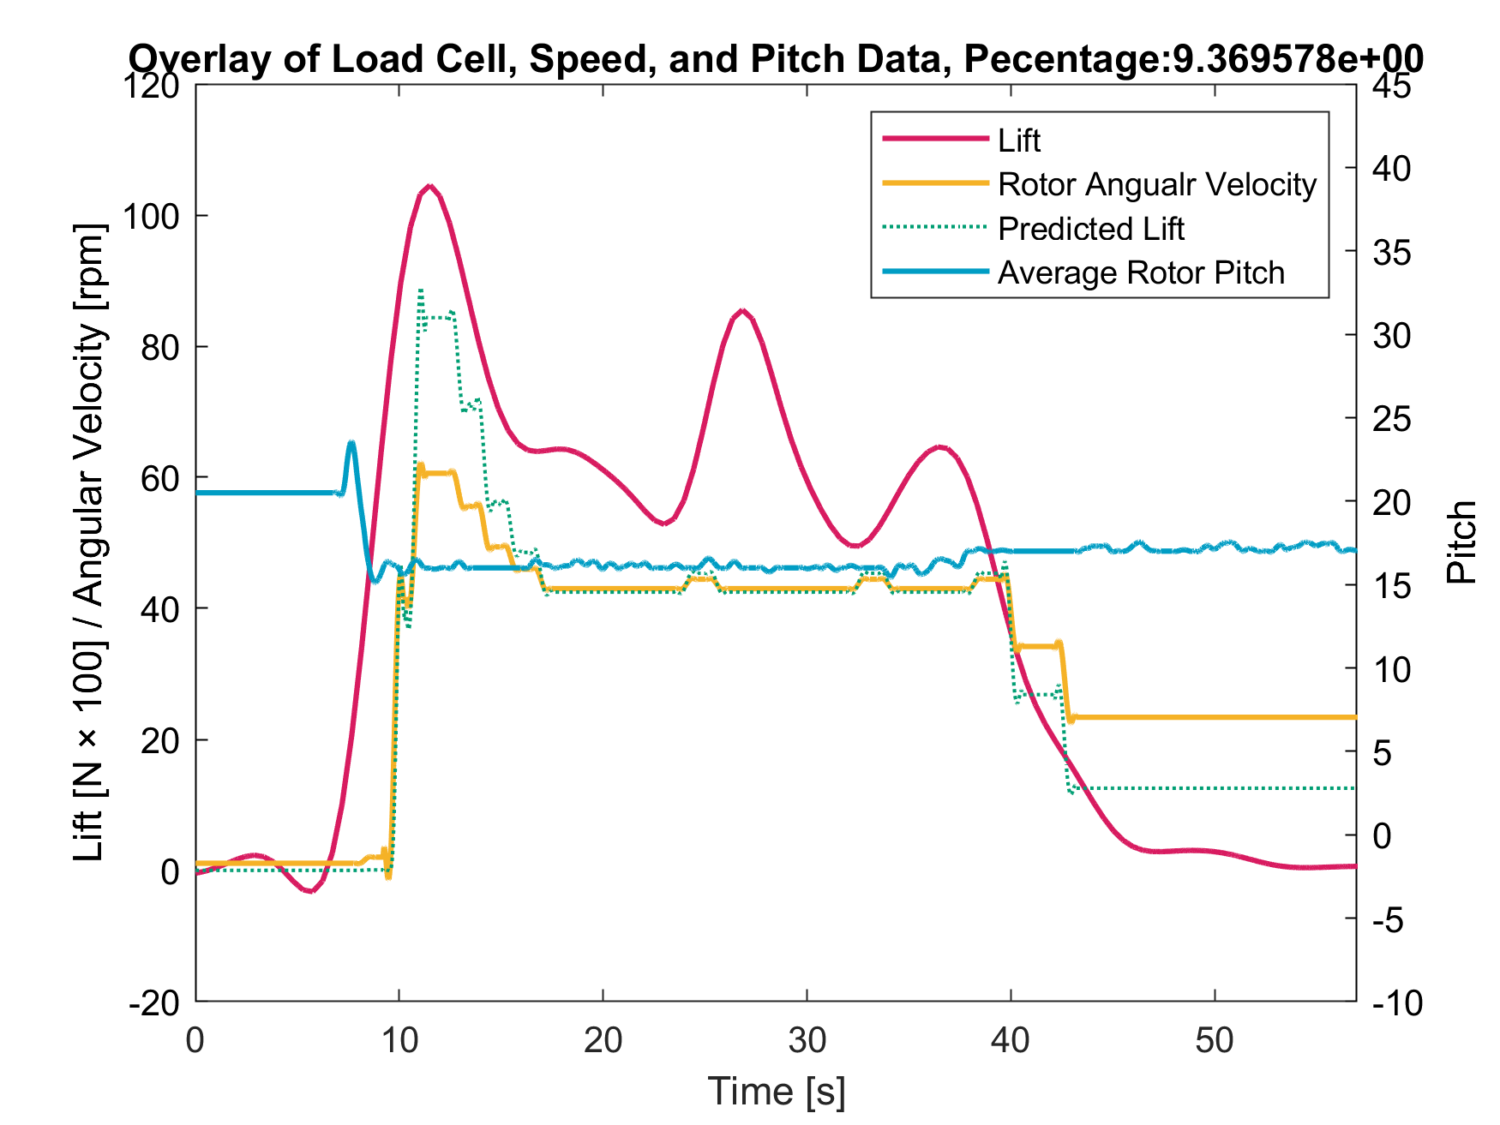
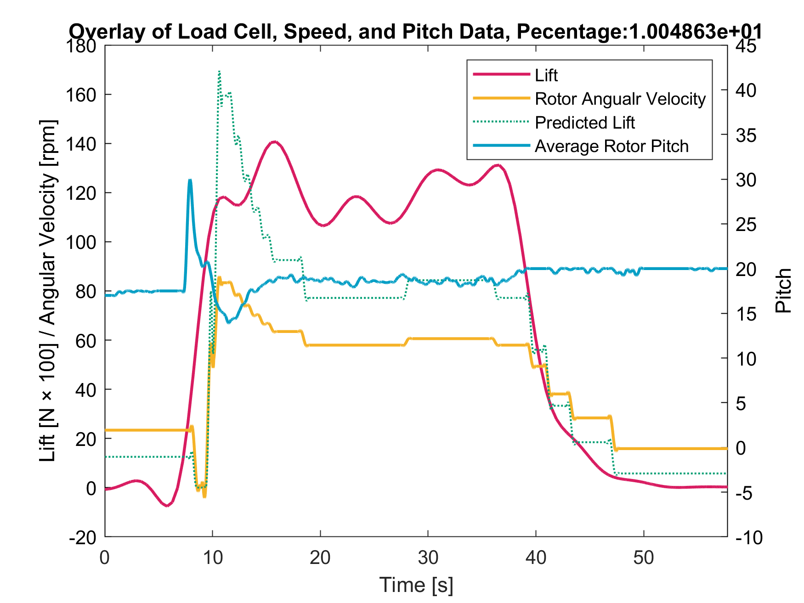
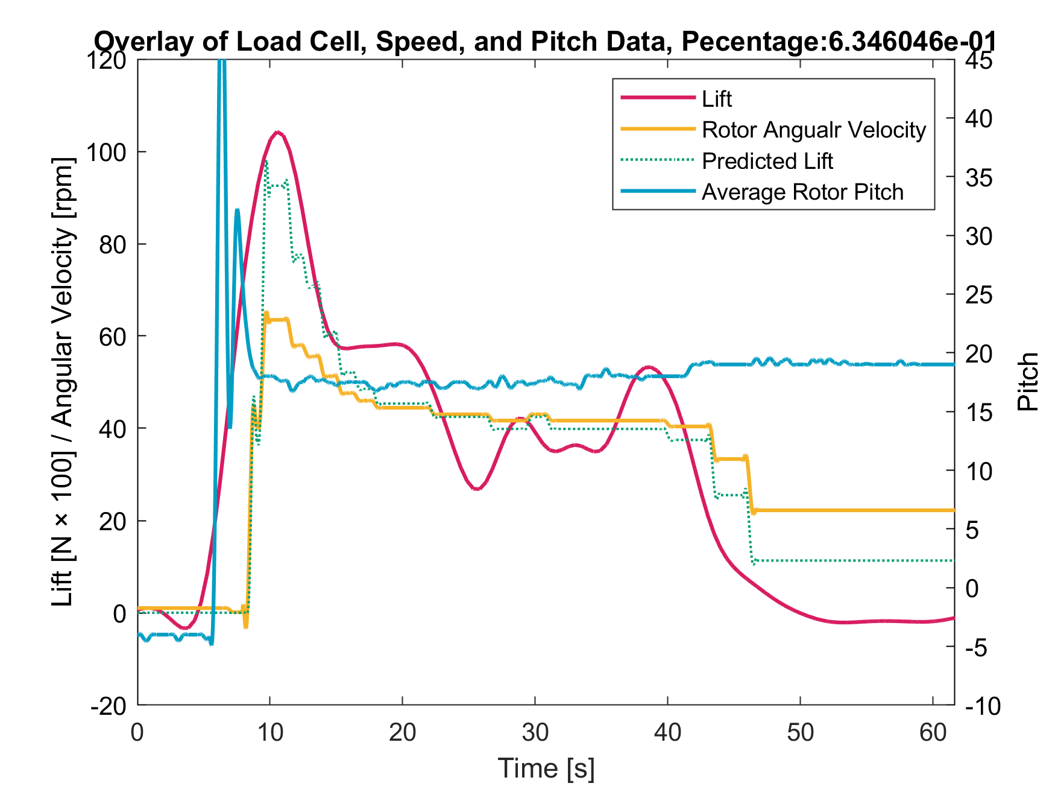
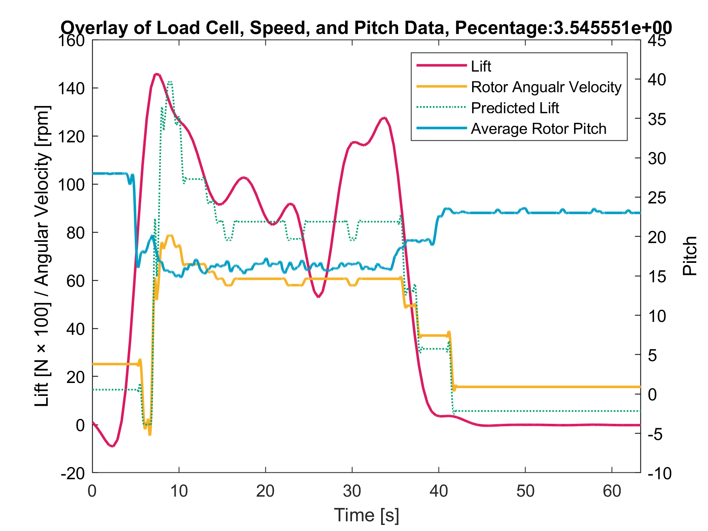
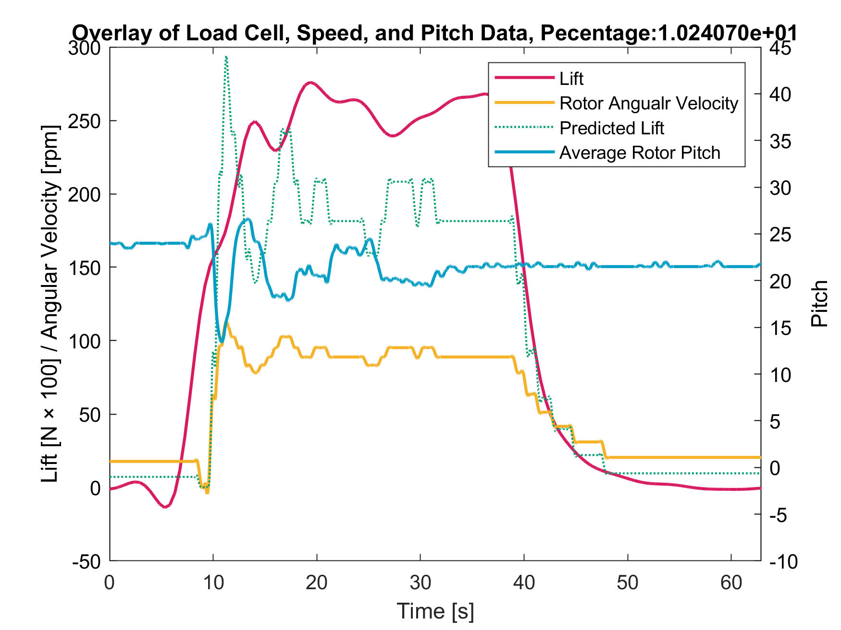
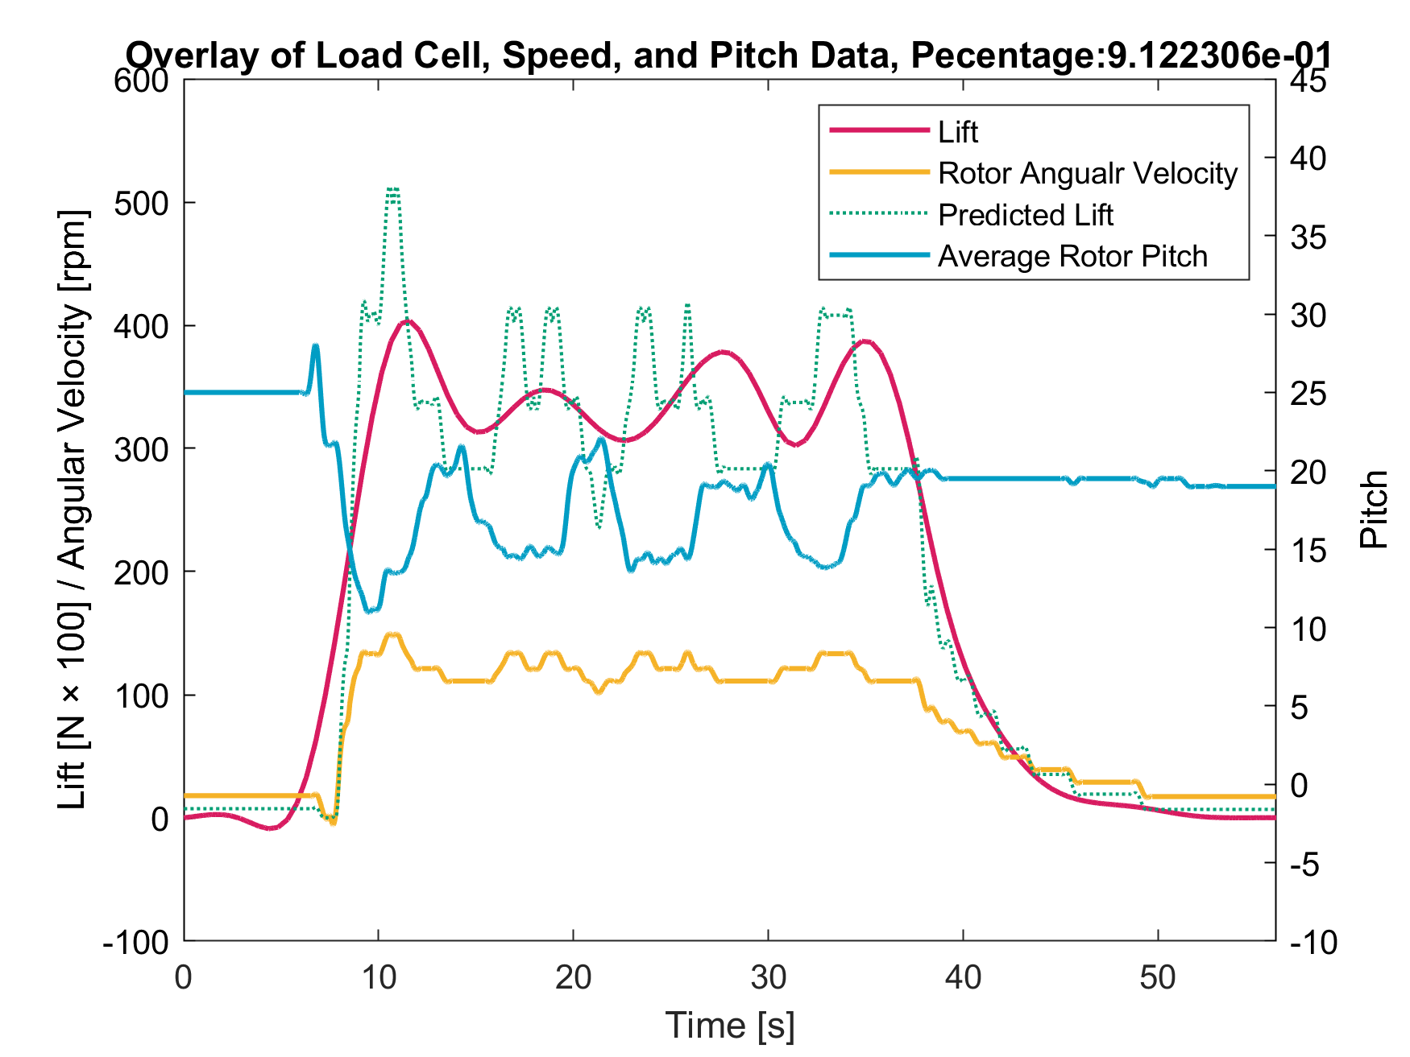
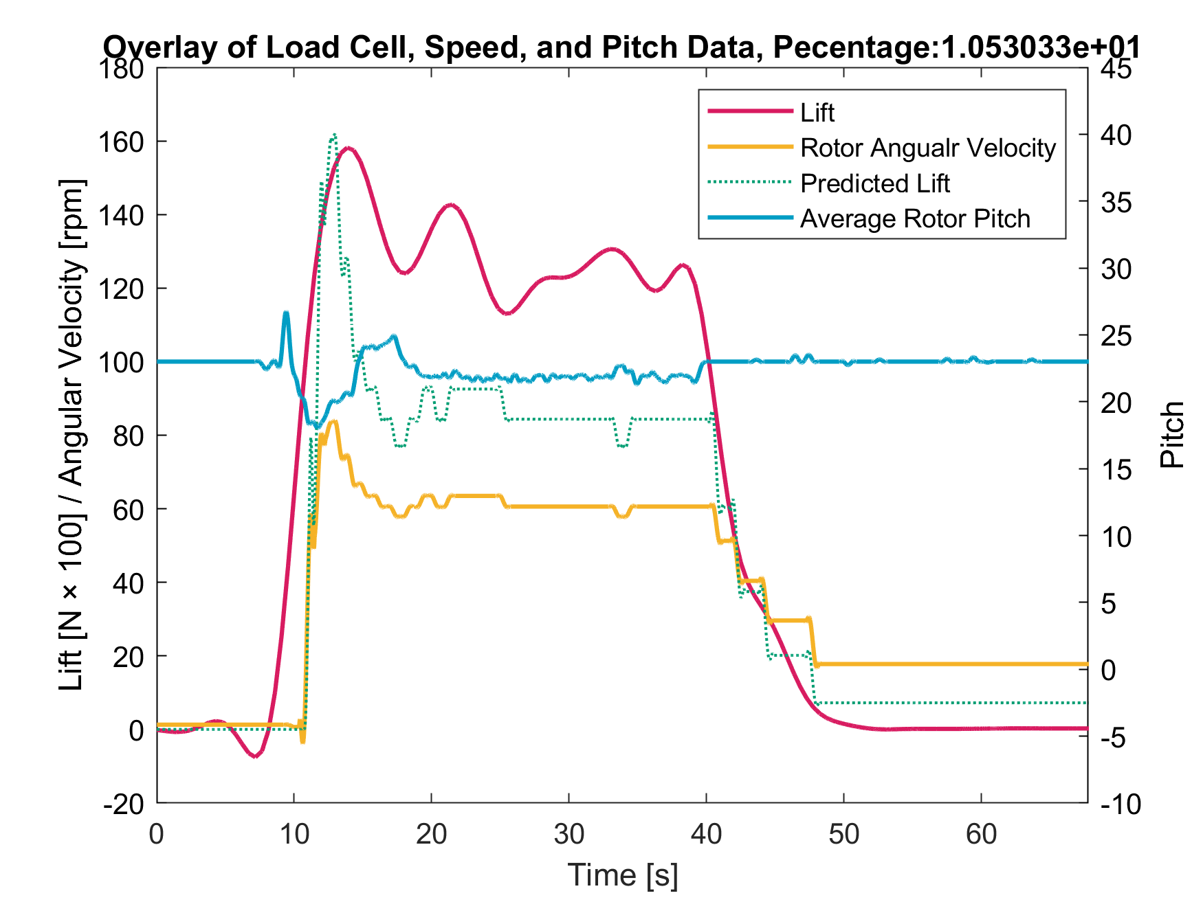
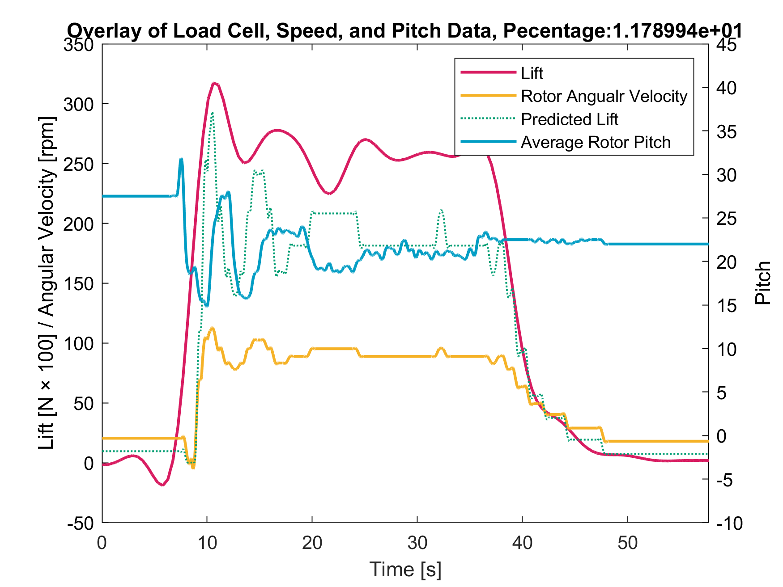
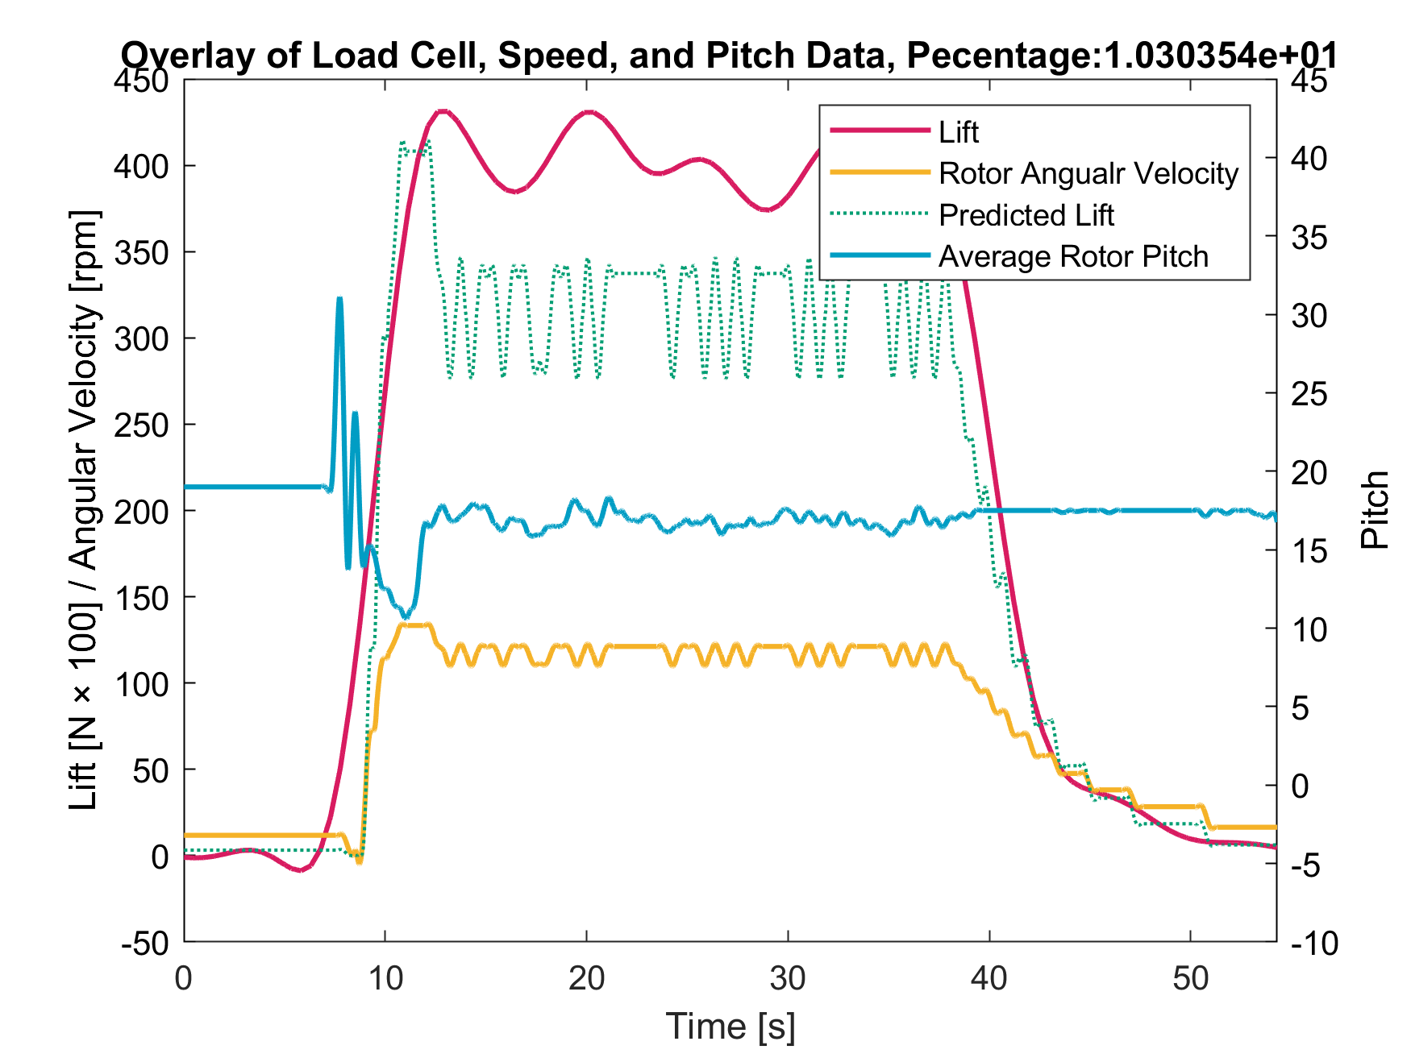
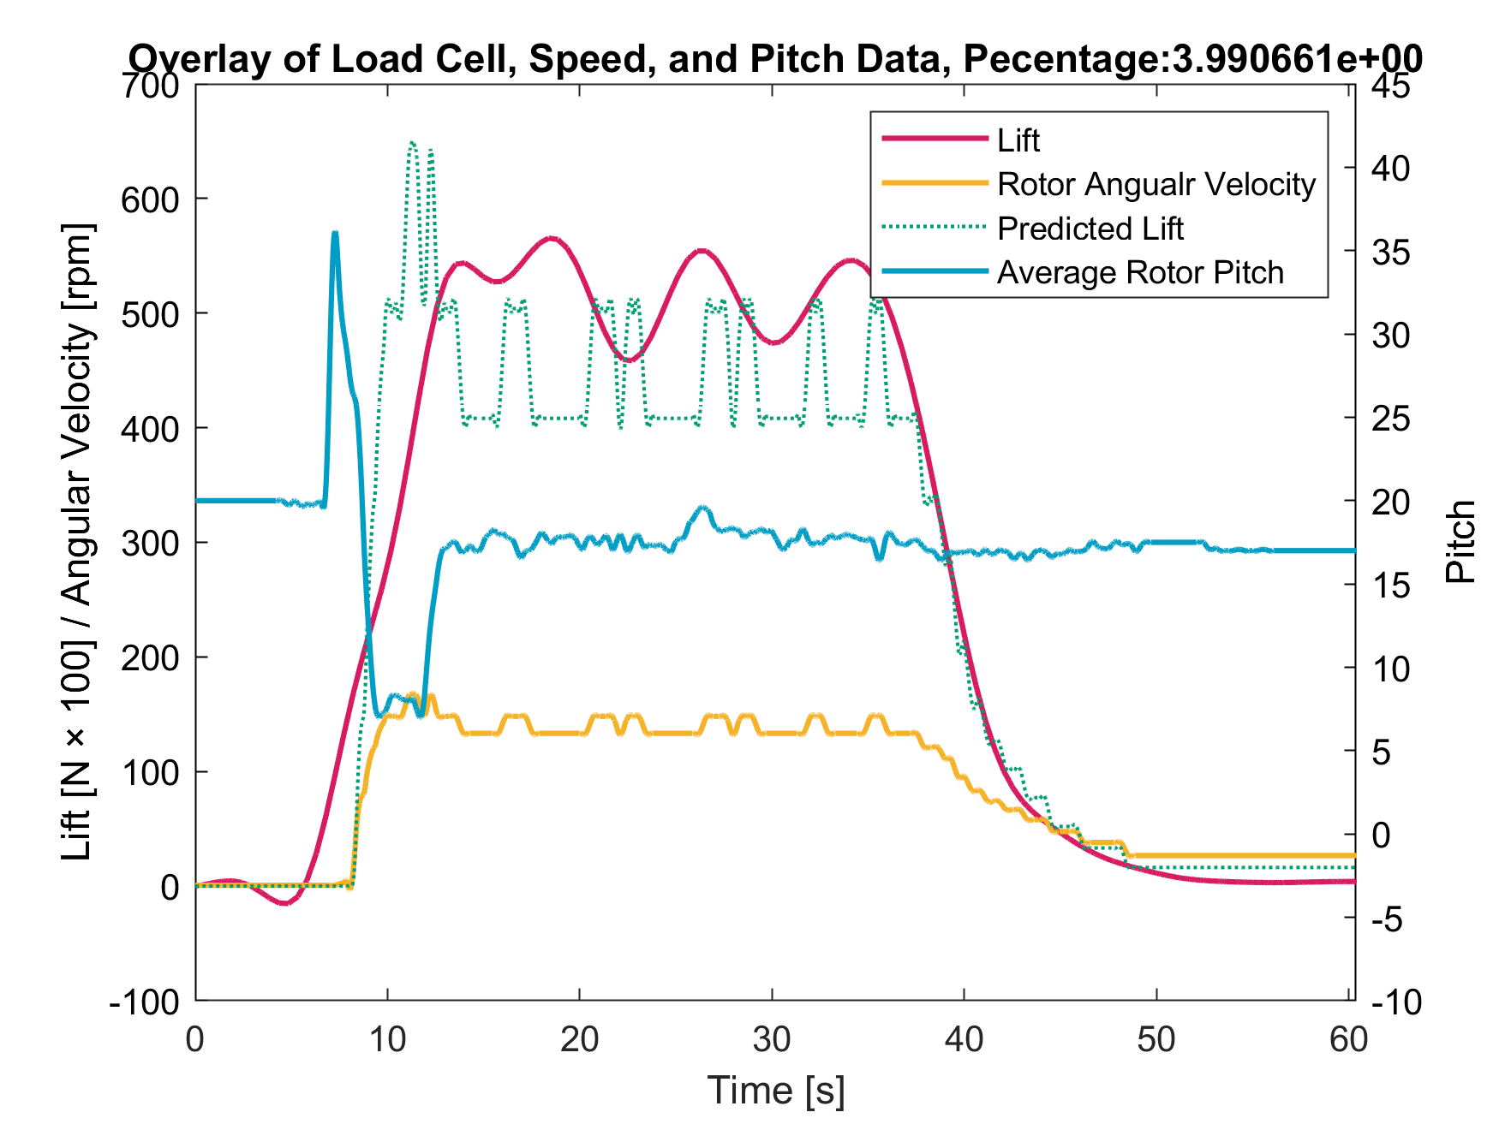
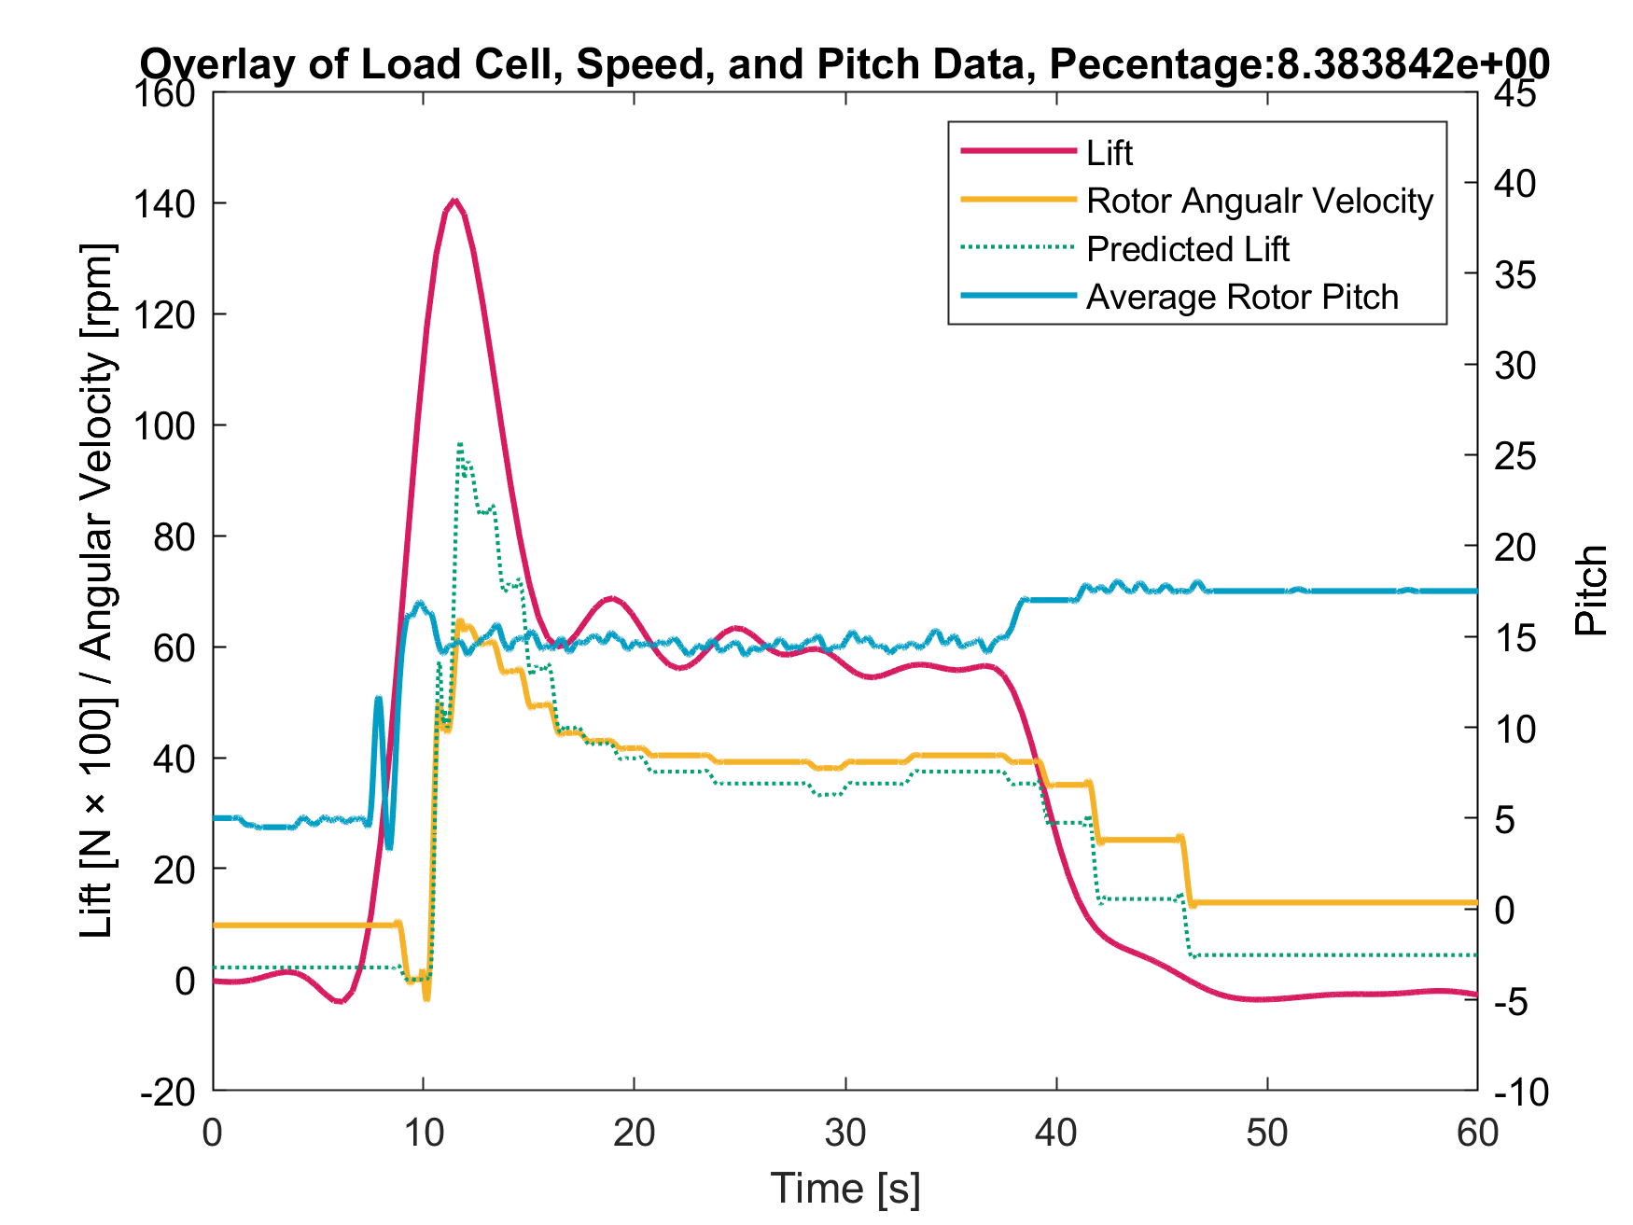
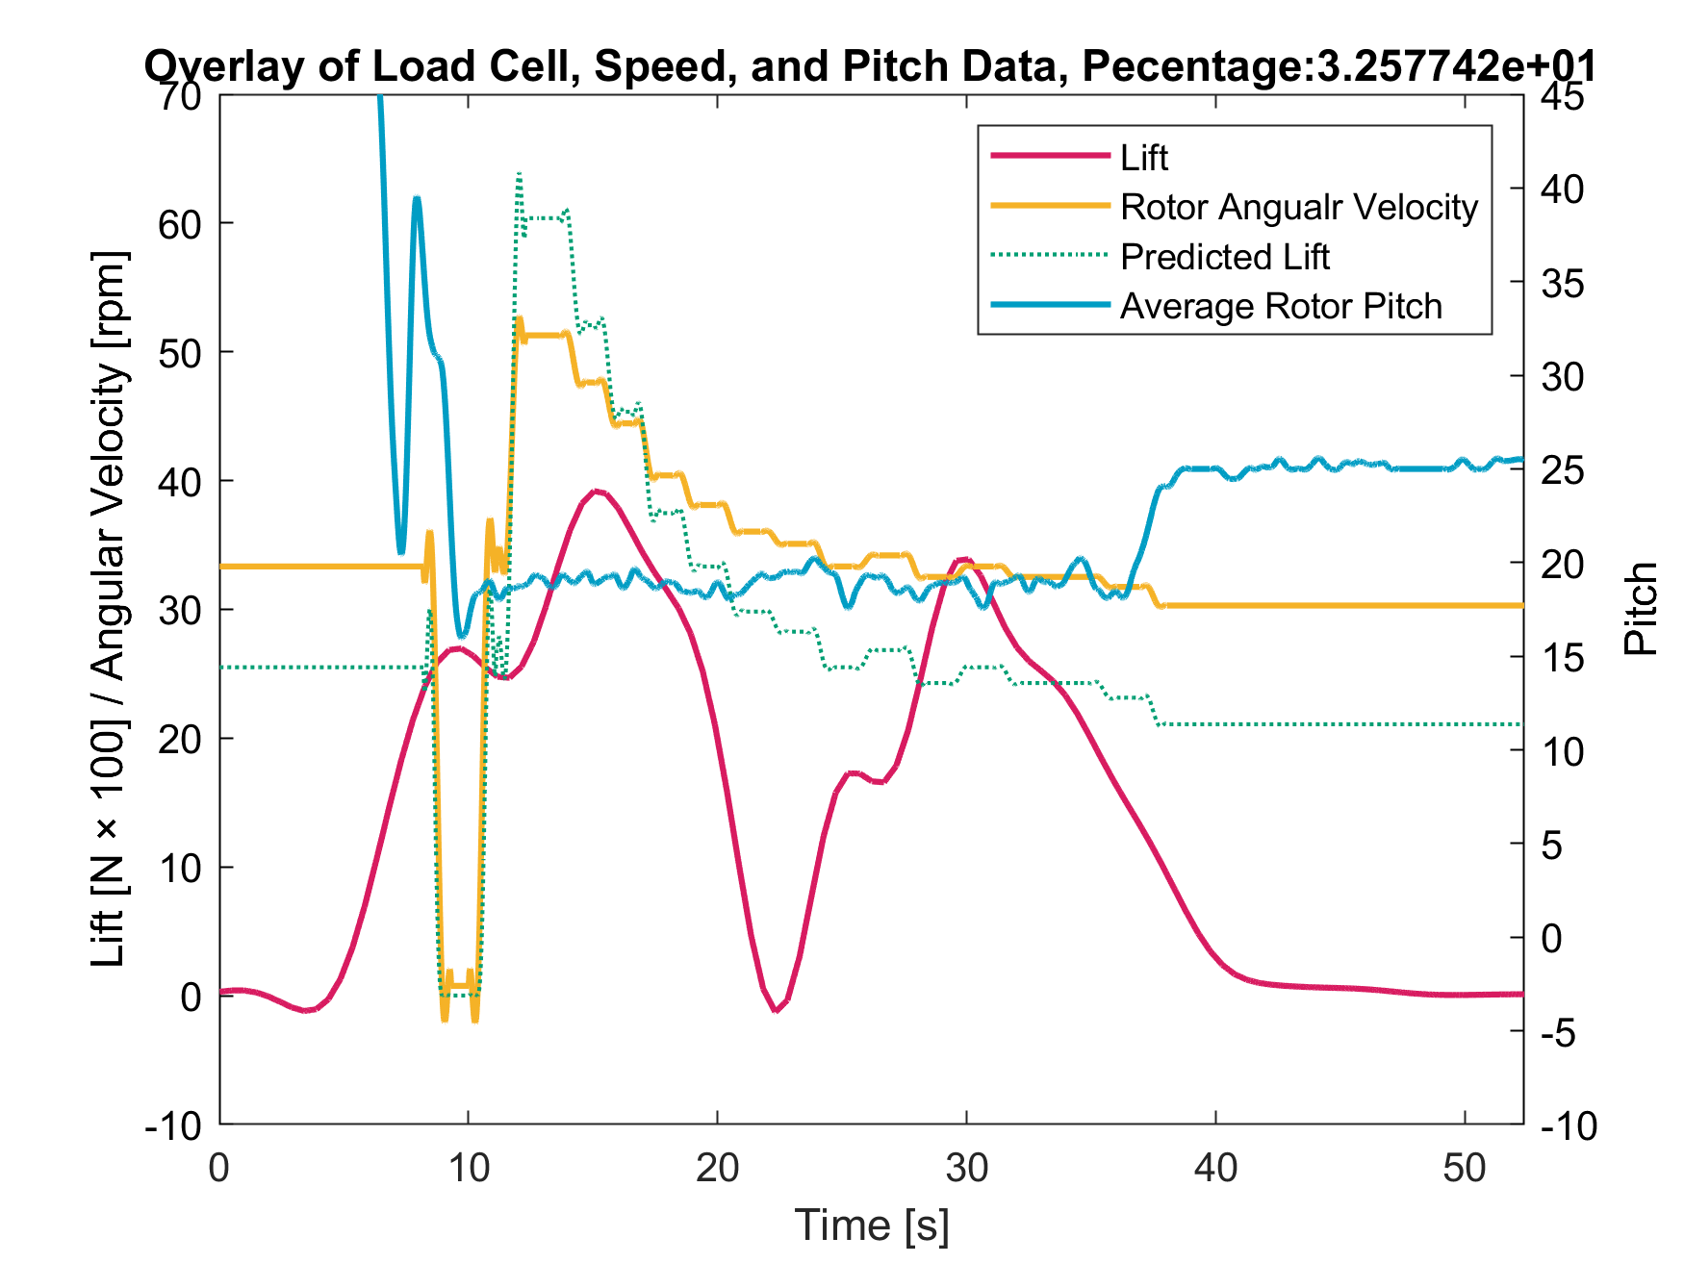

Slide 23
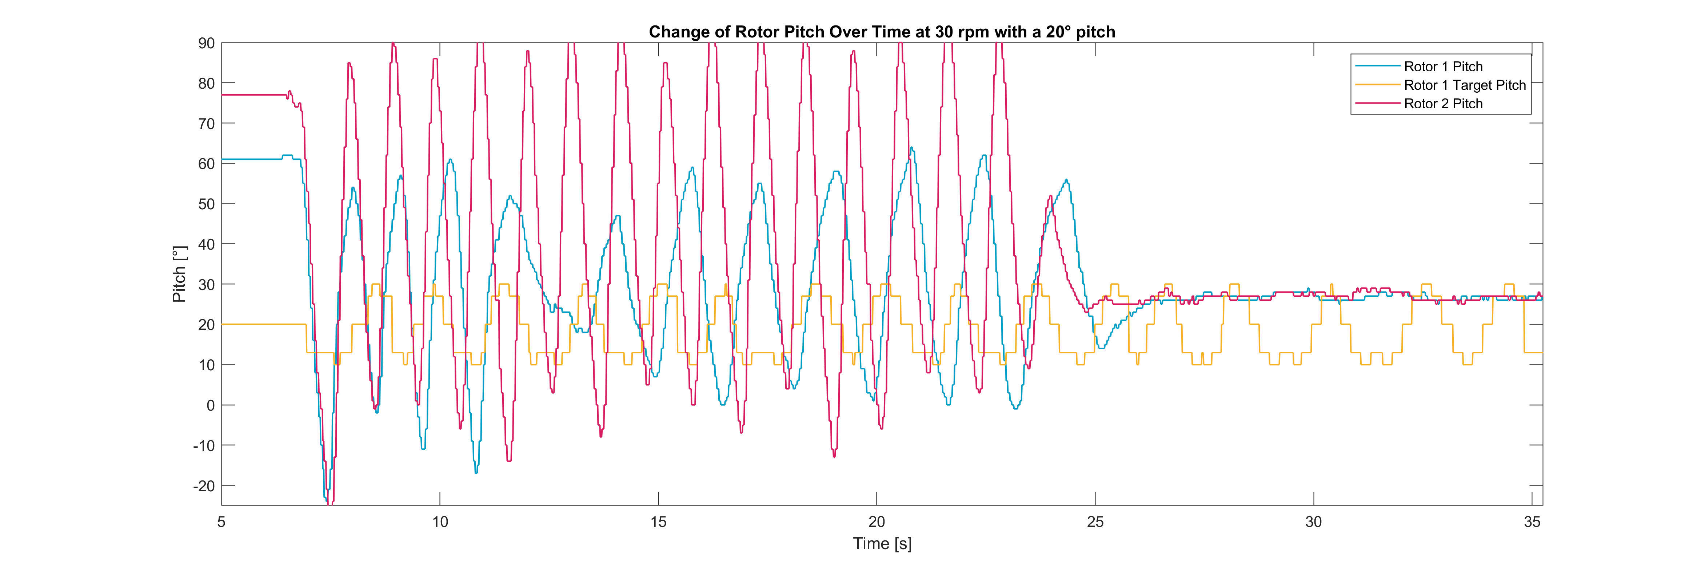
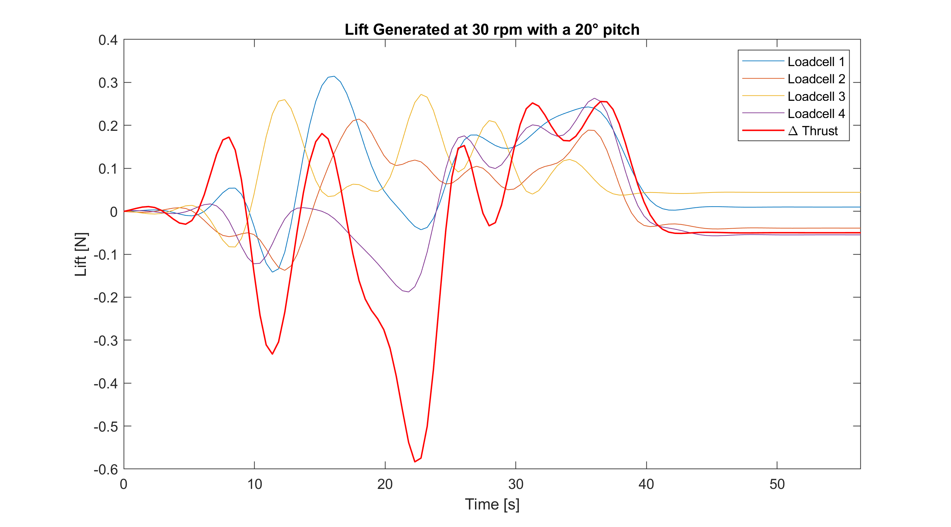
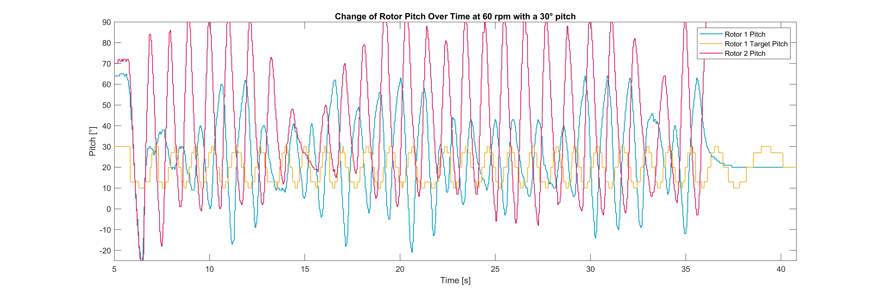
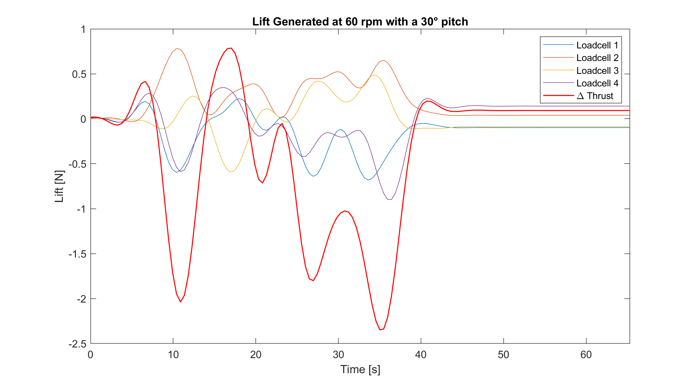
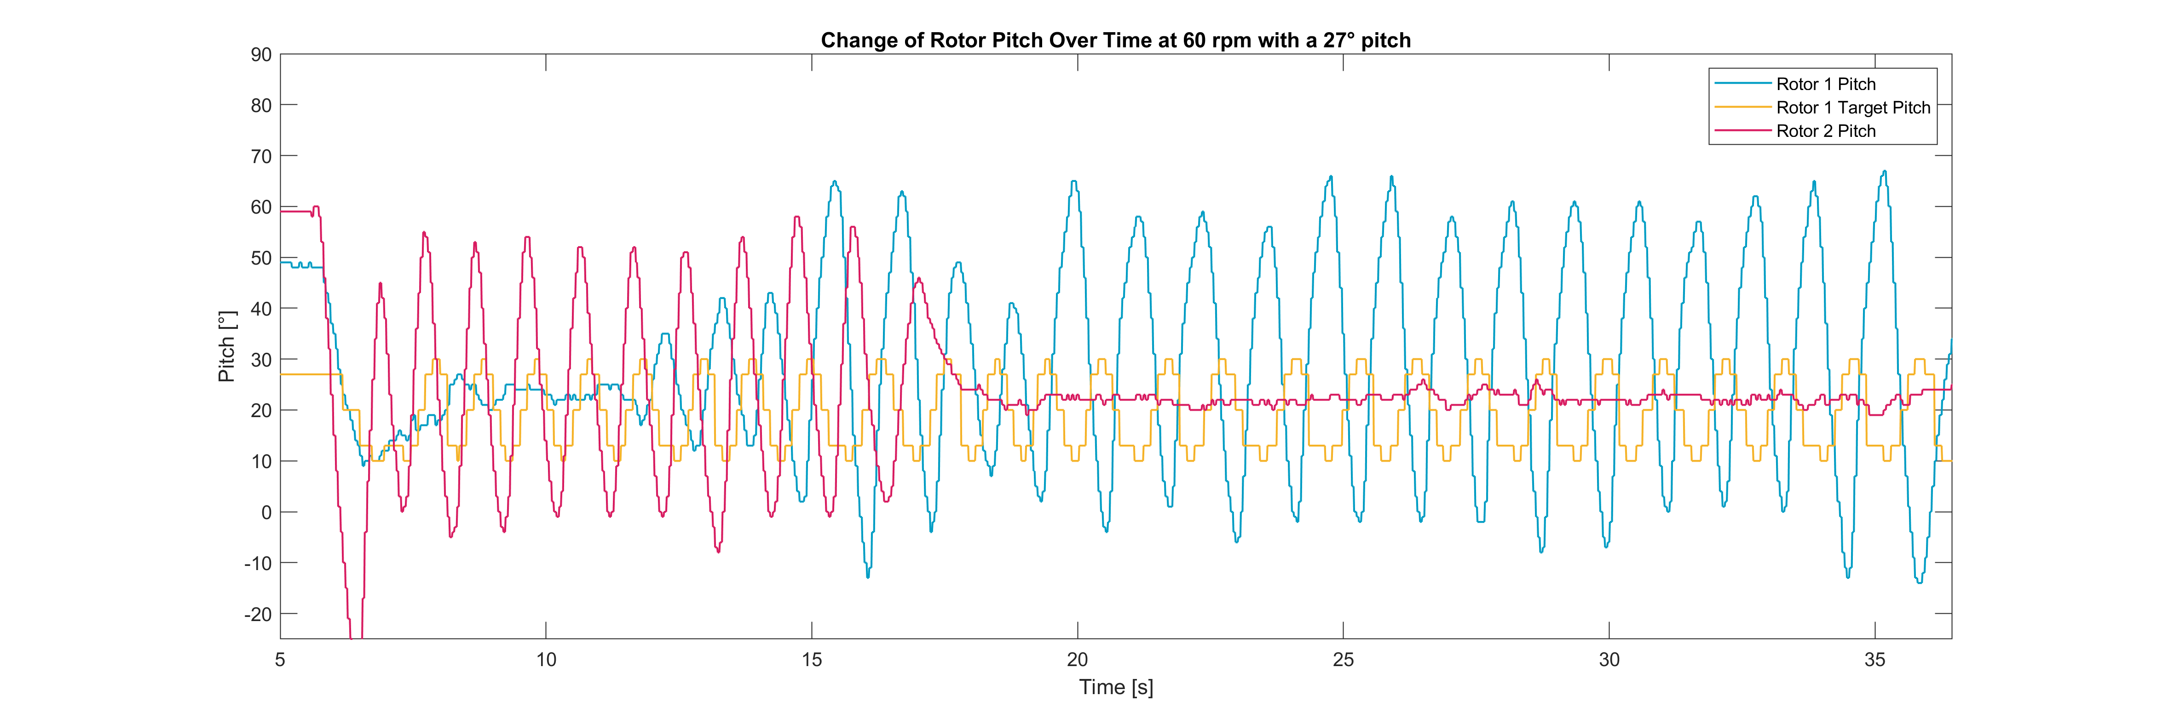
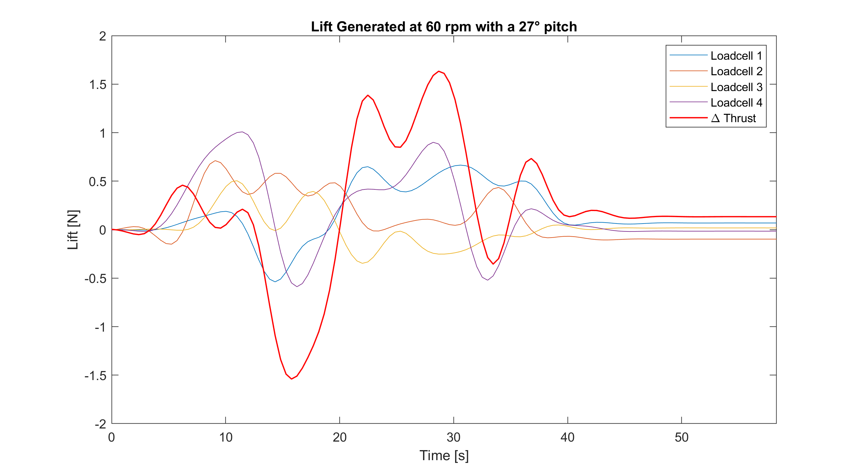

Slide 24
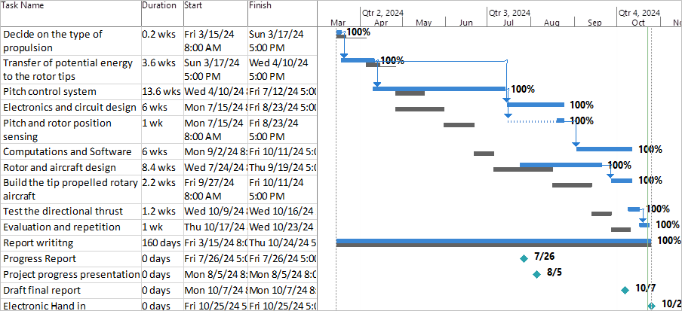
Gantt Chart

Slide 25
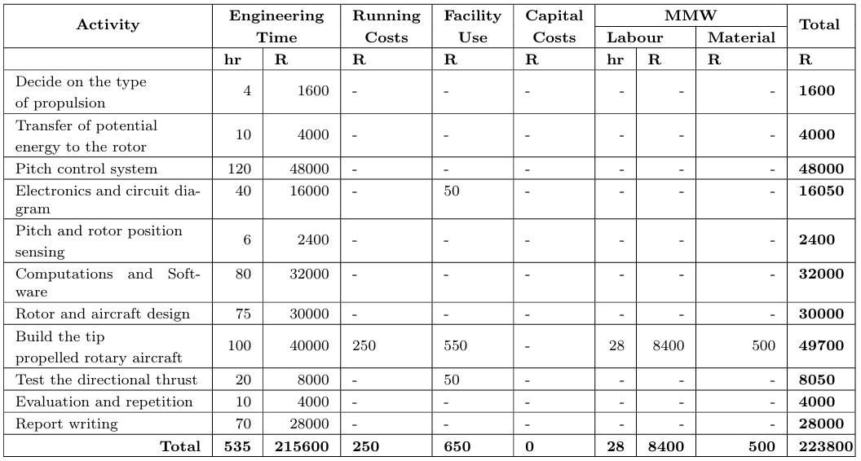
Budget

Slide 26
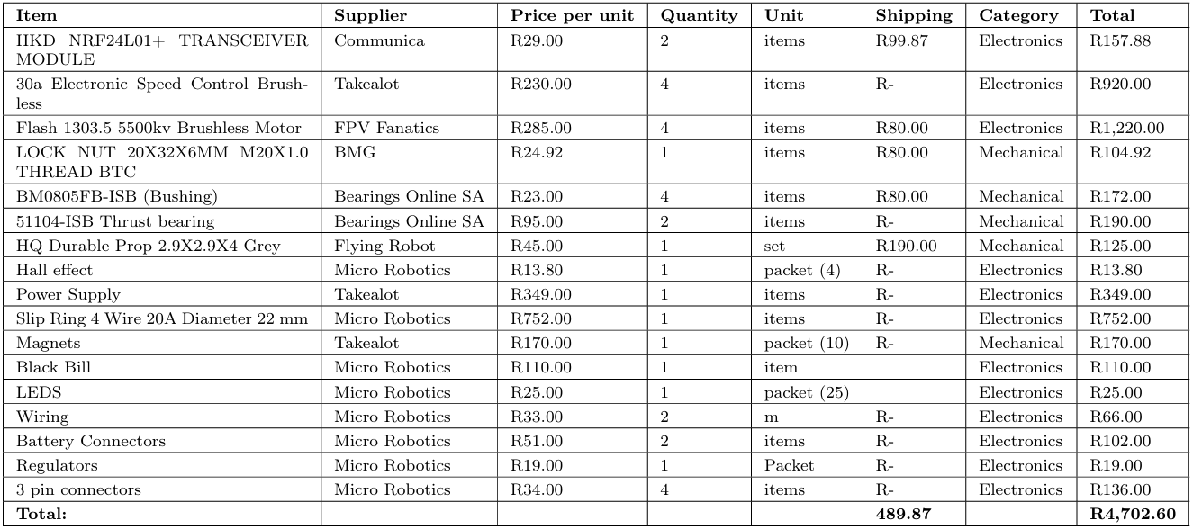
Bill of Materials

Slide 27
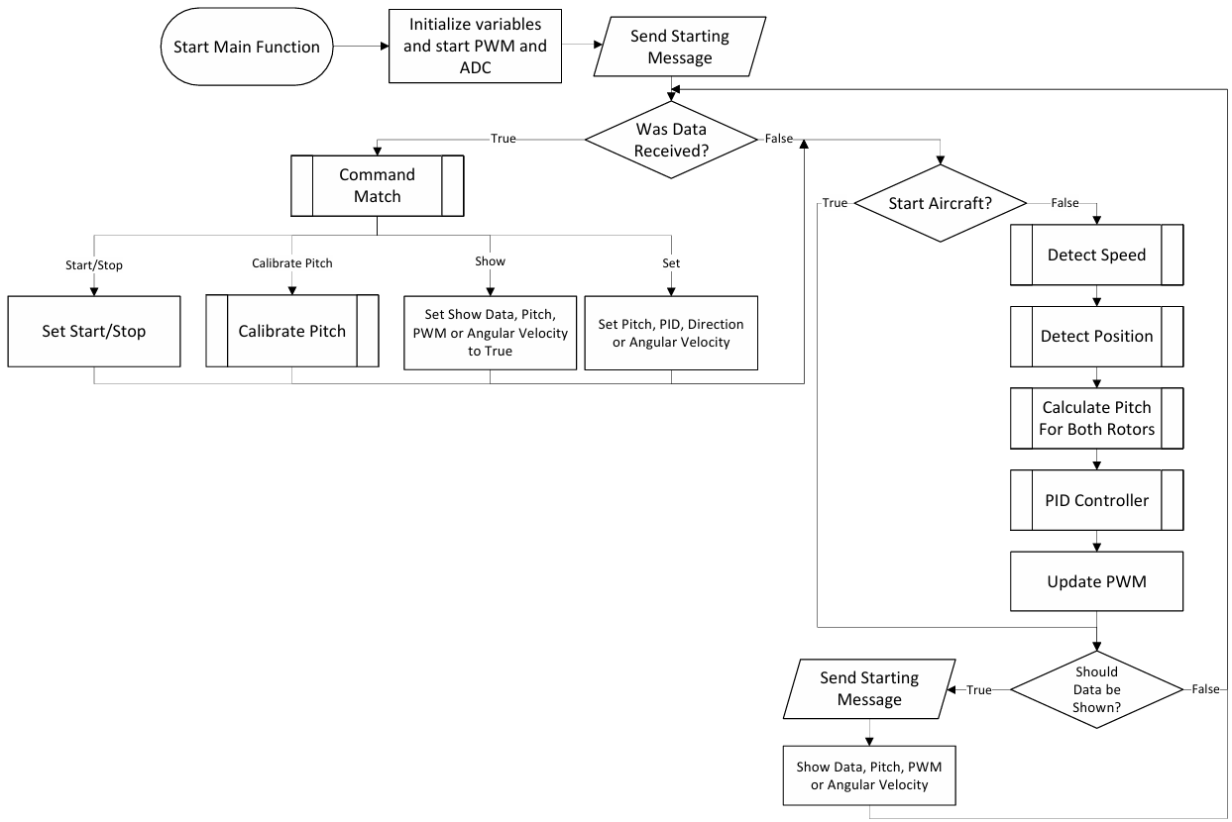
Programming

Slide 28
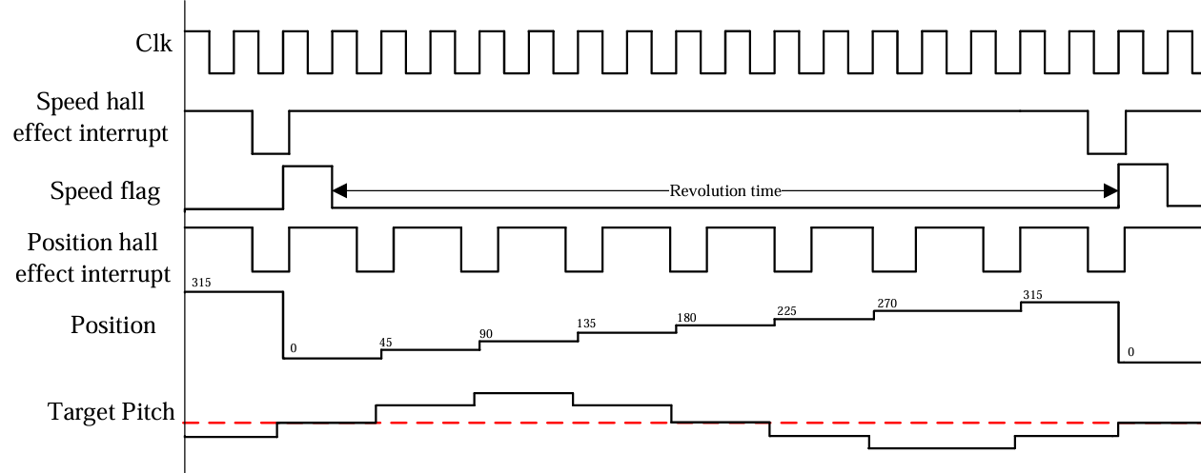
Timing Diagram
Hall effect sensors

Slide 29

Hub Sectioned

Slide 30

Hub

Slide 31

Circlip Calculations

Slide 32

Experimental Set-Up

Slide 33


User Interface

Slide 43

Thank you
Enkosi
Dankie
Photo by Stefan Els
Notes:
Cover & End Slide Option
Replace the background image: Right-click on the slide, then choose Format Background and select Picture or texture fill. Select a new picture of your choice.
Remember to add an image attribution for e.g., Photo by Stefan Els.

Slide 44

Partner logo
Partner logo
Thank you
Enkosi
Dankie
Photo by Stefan Els
Notes:
Co-branded End Slide Option
Replace the background image: Right-click on the slide, then choose Format Background and select Picture or texture fill. Select a new picture of your choice.
Remember to add an image attribution for e.g., Photo by Stefan Els.

